Slide 1
CT and MRI Sectional Anatomy
Tom Haller, RT (R)(CT)(MR)(ARRT)

Slide 2
Course Objectives:
At the completion of this course, the participant will be able to:
1. Identify the anatomy of the head, neck, chest, abdomen, pelvis, upper and lower extremities in sectional orientation on diagrams, CT and MRI images.
2. Identify anatomical structures as seen in multiple orthogonal planes on diagrams, CT and MRI images.
3. Describe gross anatomic relationships in the body.
4. Describe anterior-posterior, proximal-distal, lateral-medial and superior-inferior relationships of anatomy.

Slide 3
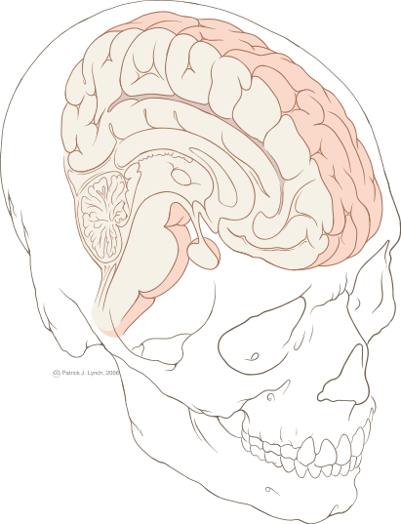
Major Divisions of the Brain
Cerebrum
Cerebellum
Brainstem
Patrick J. Lynch; illustrator; C. Carl Jaffe; MD; cardiologist Yale University Center for Advanced Instructional Media Medical Illustrations

Slide 4
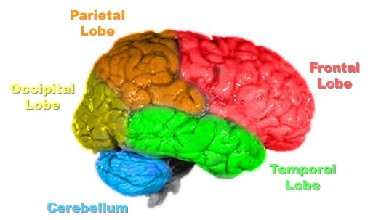
Outer Lobes of the Cerebrum, including the Cerebellum
Lobes of the brain, color-coded. Based on Image:Human_brain_NIH.jpg.

Slide 5
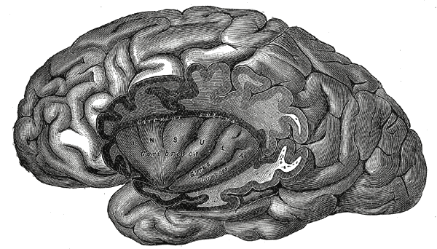
The Insular lobe of the Cerebrum
http://upload.wikimedia.org/wikipedia/commons

Slide 6
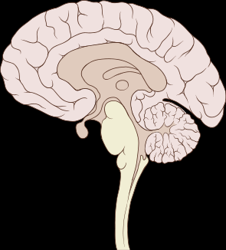
Portions of the Brainstem
Midbrain
Pons
Medulla Oblongata
Patrick J. Lynch; illustrator; C. Carl Jaffe; MD; cardiologist Yale University Center for Advanced Instructional Media Medical Illustrations

Slide 7
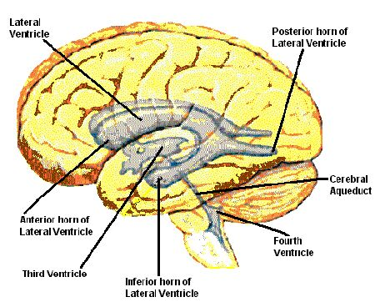
The Ventricular System
http://members.aol.com/dcaronejr/ezmed/fourth.jpg

Slide 8
The cisternal system
https://www.google.com/search?q=cisterns+brain&espv

Slide 9
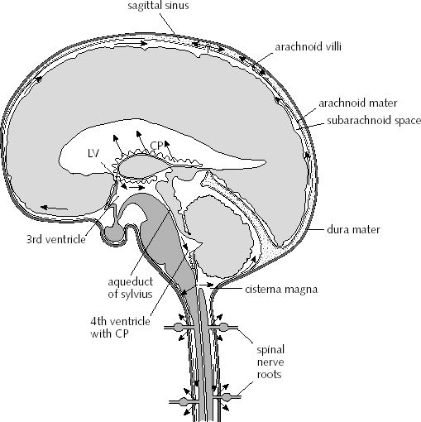
Flow of CSF around the Brain
http://content.answers.com/main/content/img/oxford/Oxford_Body/019852403x.cerebrospinal-fluid.1.jpg

Slide 10
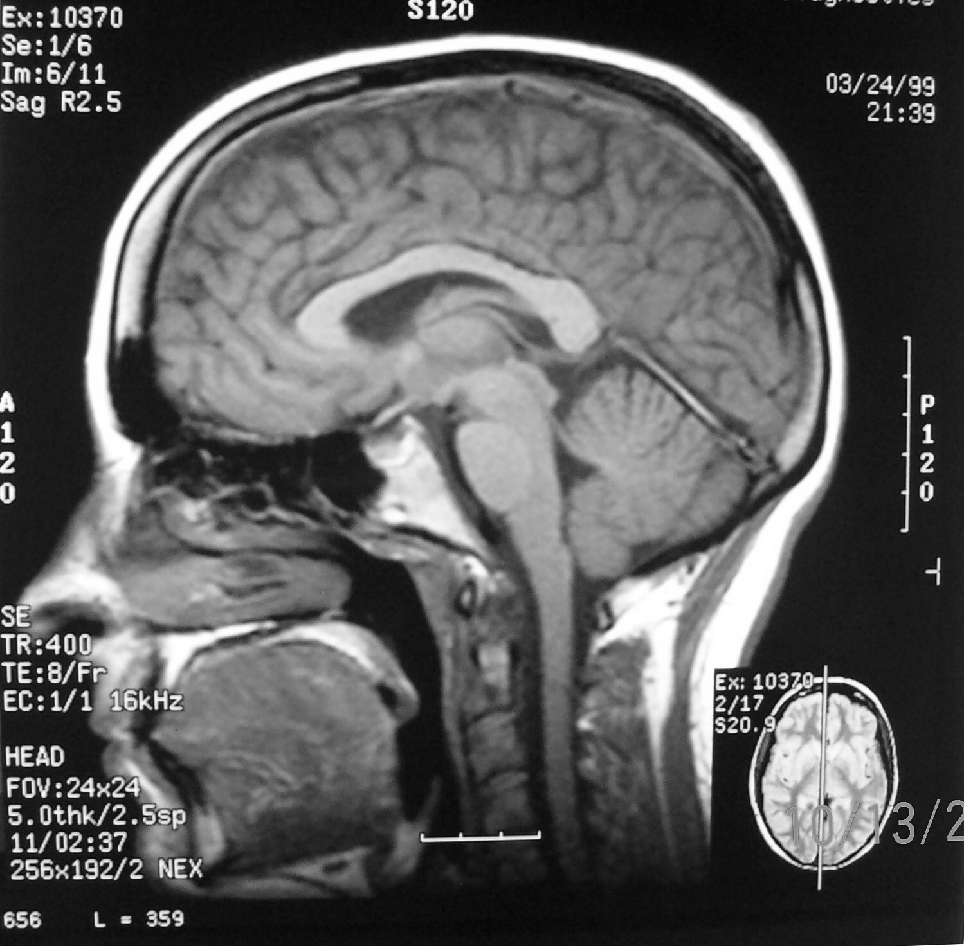
Median Sagittal Slice – T1 weighting
Ventricles
Third Ventricle
Lateral Ventricles
Cerebral Aqueduct
Interventricular Foramina
Fourth Ventricle

Slide 11
Median Sagittal Slice – T1 weighting
Cisterns
Chiasmatic Cistern
Superior Cistern
Interpeduncular Cistern
Cerebellomedullary Cistern
Pontine Cistern

Slide 12
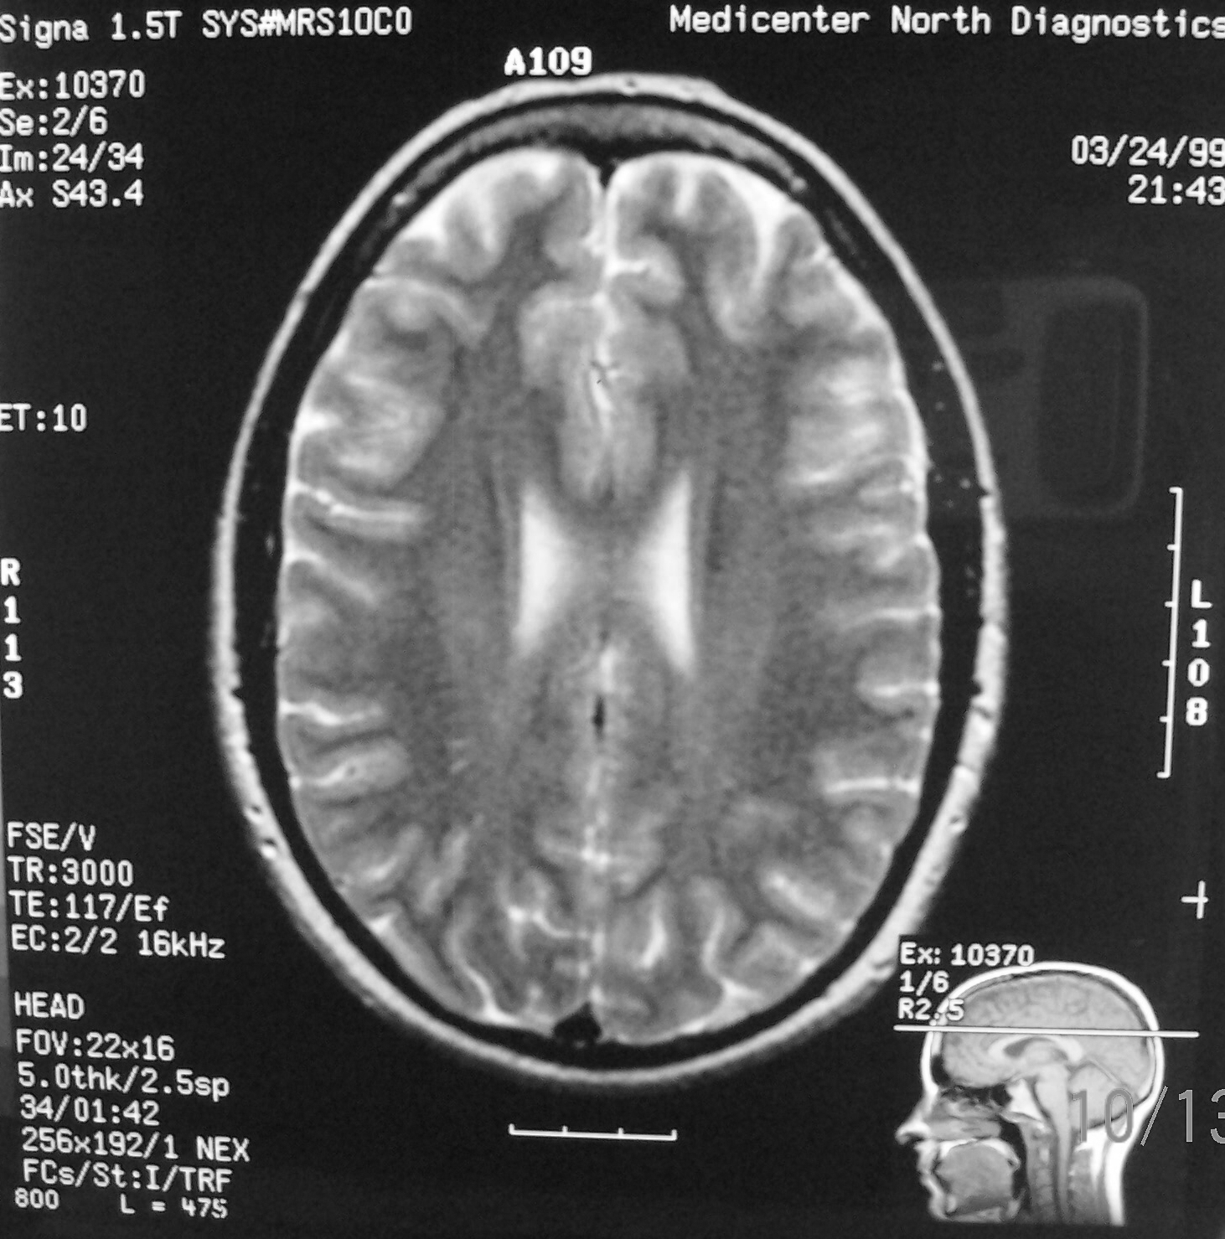
Axial – T2 Weighting
Lat vent

Slide 13
Axial – T2 Weighting
Body of Corpus Callosum
Caudate Nucleus

Slide 14
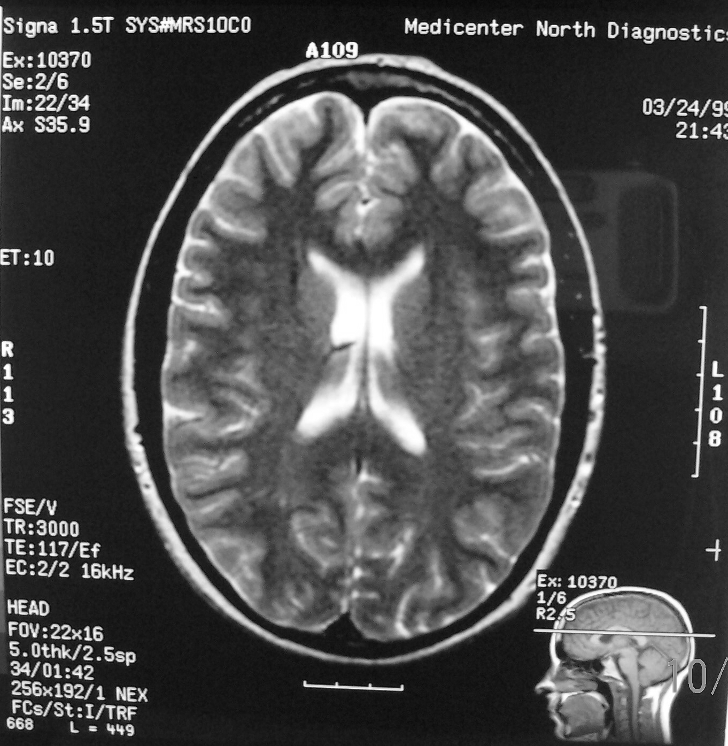
Axial – T2 Weighting
Septum Pellucidum
Lateral Ventricle
Choroid Plexus

Slide 15
Axial – T2 Weighting
Genu of Corpus Callosum
Caudate Nucleus
Splenium of Corpus Callosum

Slide 16
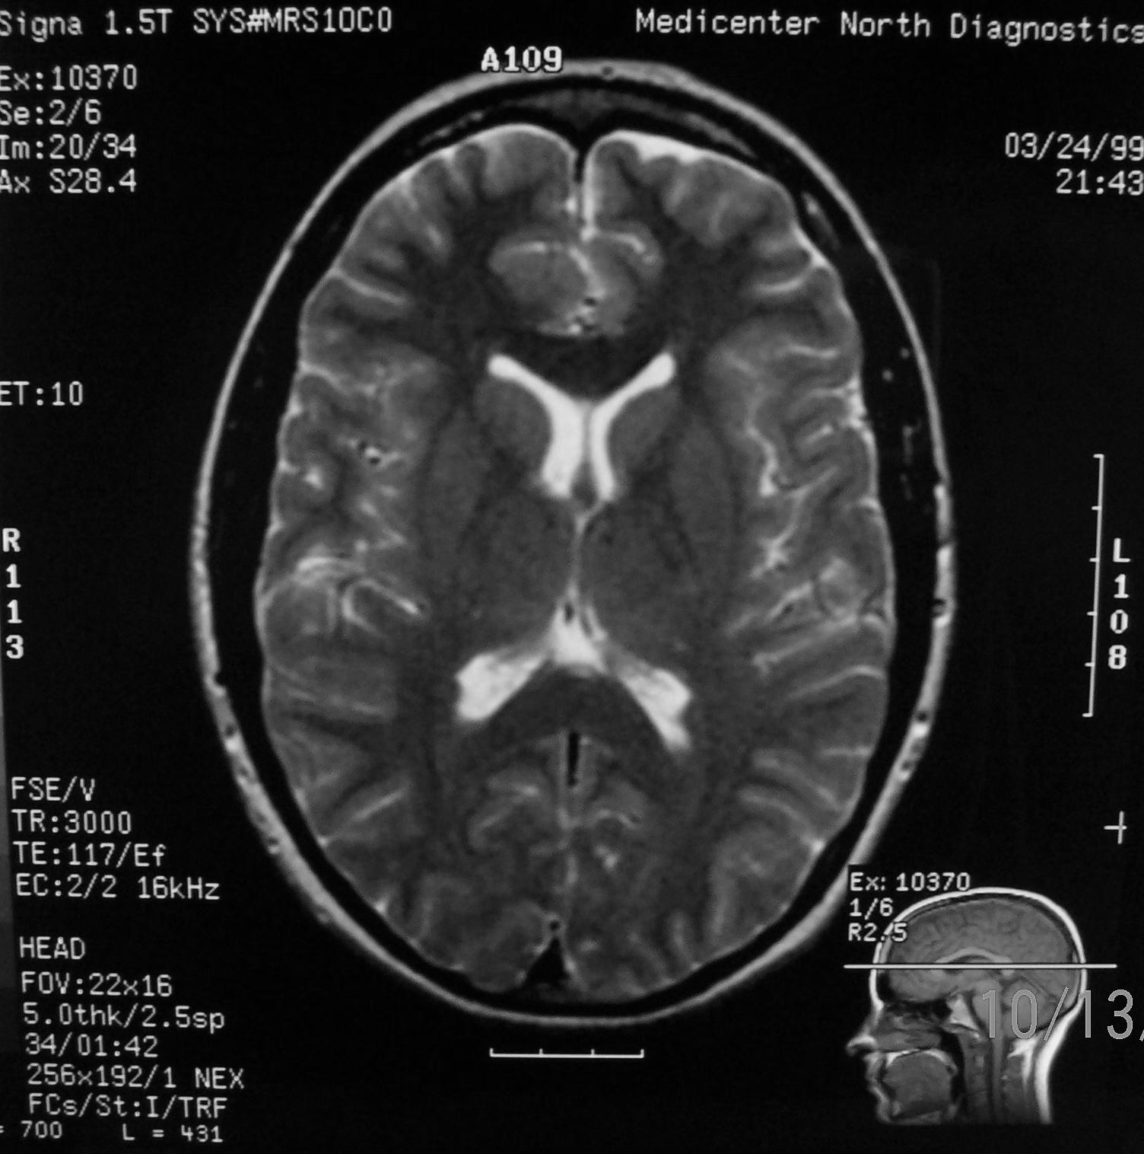
Axial – T2 Weighting
Anterior Horn of Lateral Ventricle
Third Ventricle
Interventricular Foramen
Superior Cistern

Slide 17
Axial – T2 Weighting
Genu
Splenium
Thalamus

Slide 18
Axial – T2 Weighting
Head of Caudate Nucleus
Internal Capsule
Lentiform Nucleus
External Capsule

Slide 19
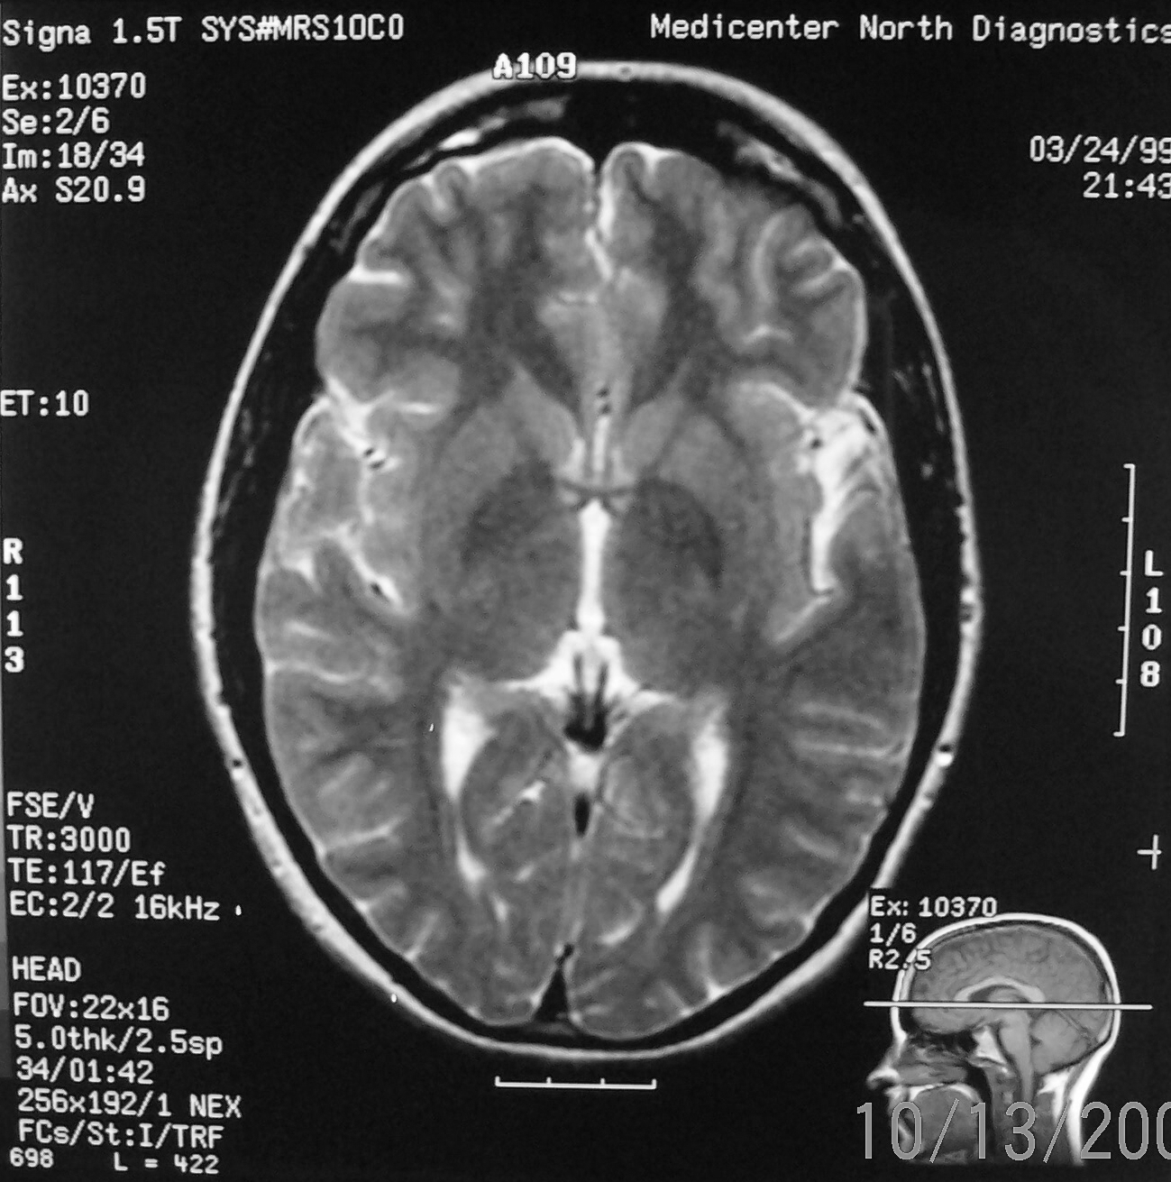
Axial – T2 Weighting
Cistern of Lateral Sulcus
Third Ventricle
Superior Cistern
Posterior Horn of Lateral Ventricle

Slide 20
Axial – T2 Weighting
Internal Capsule
Head of Caudate Nucleus
External Capsule
Putamen
Globus Pallidus
Claustrum

Slide 21
Axial – T2 Weighting
Branch of Anterior Cerebral Artery
Great Cerebral Vein
Branch of Middle Cerebral Artery
Straight Sinus
Superior Sagittal Sinus

Slide 22
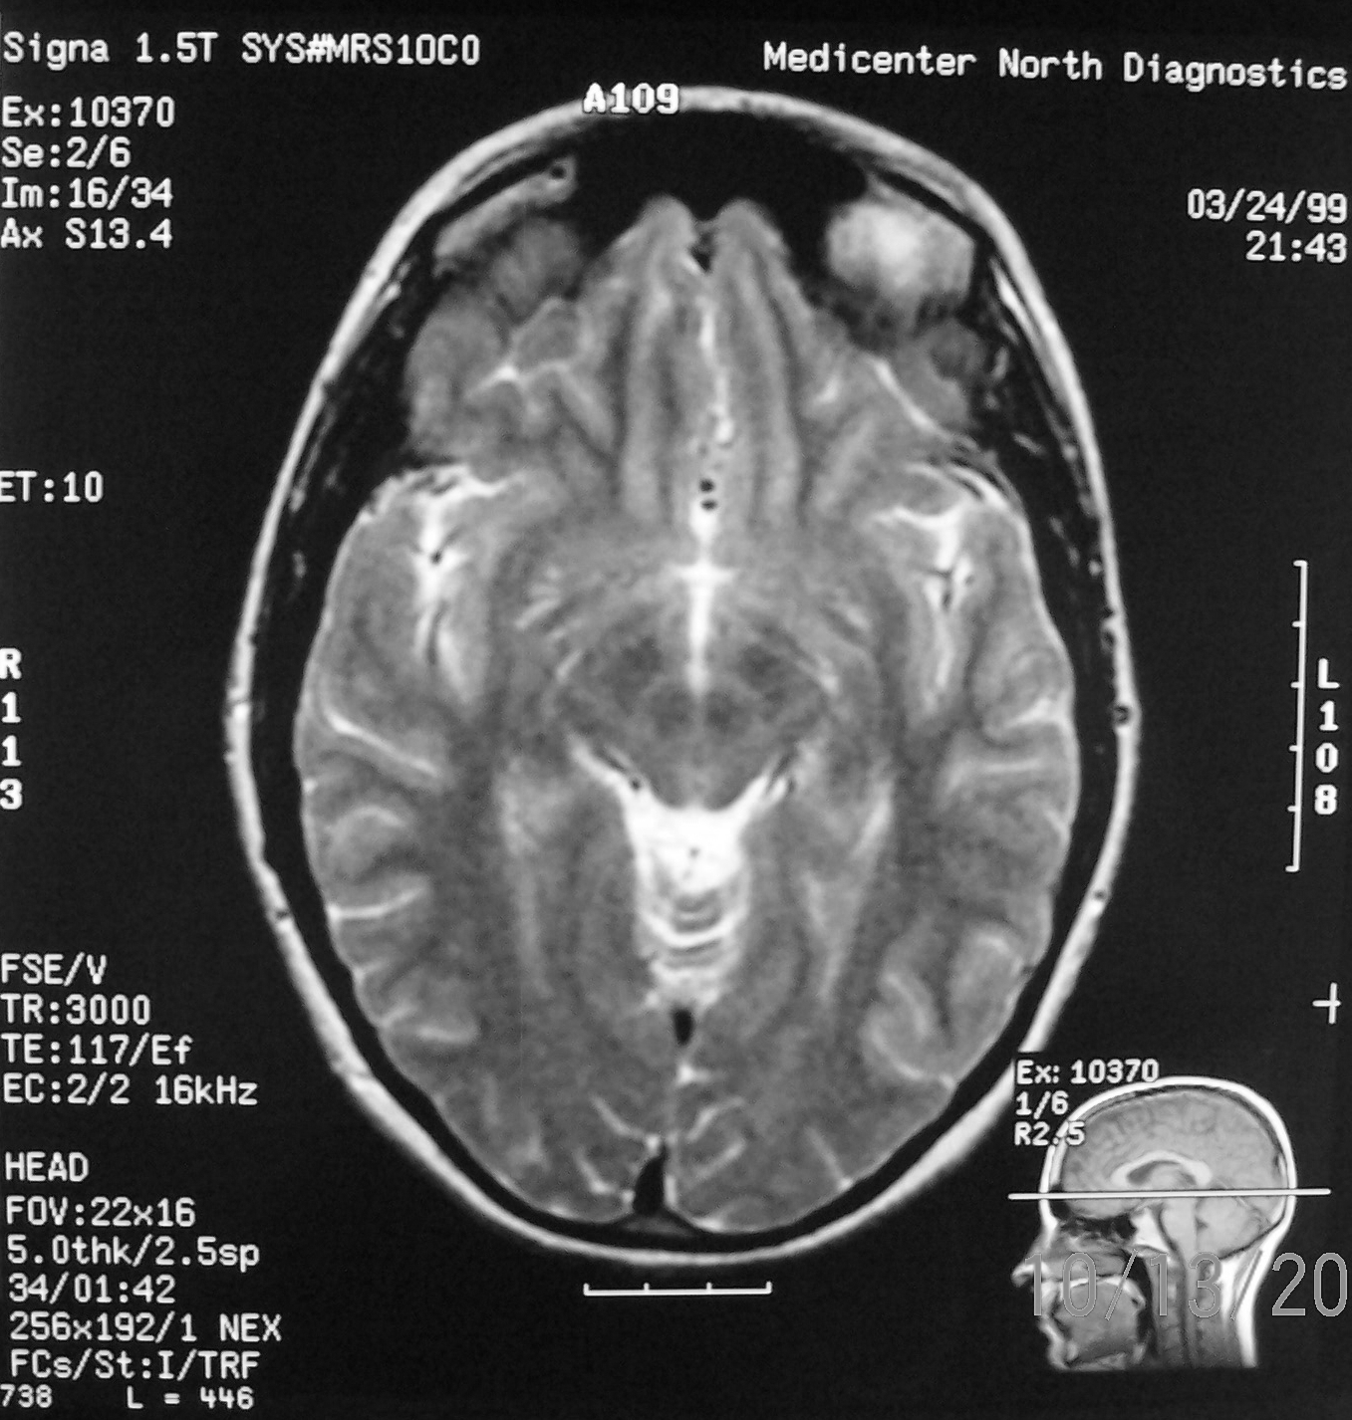
Axial – T2 Weighting
Cistern of Lateral Sulcus
Cerebral Aqueduct
Interpeduncular Cistern
Superior Cistern

Slide 23
Axial – T2 Weighting
Cerebral Peduncle
Cerebellar Vermis
Corpora Quadrigemina

Slide 24
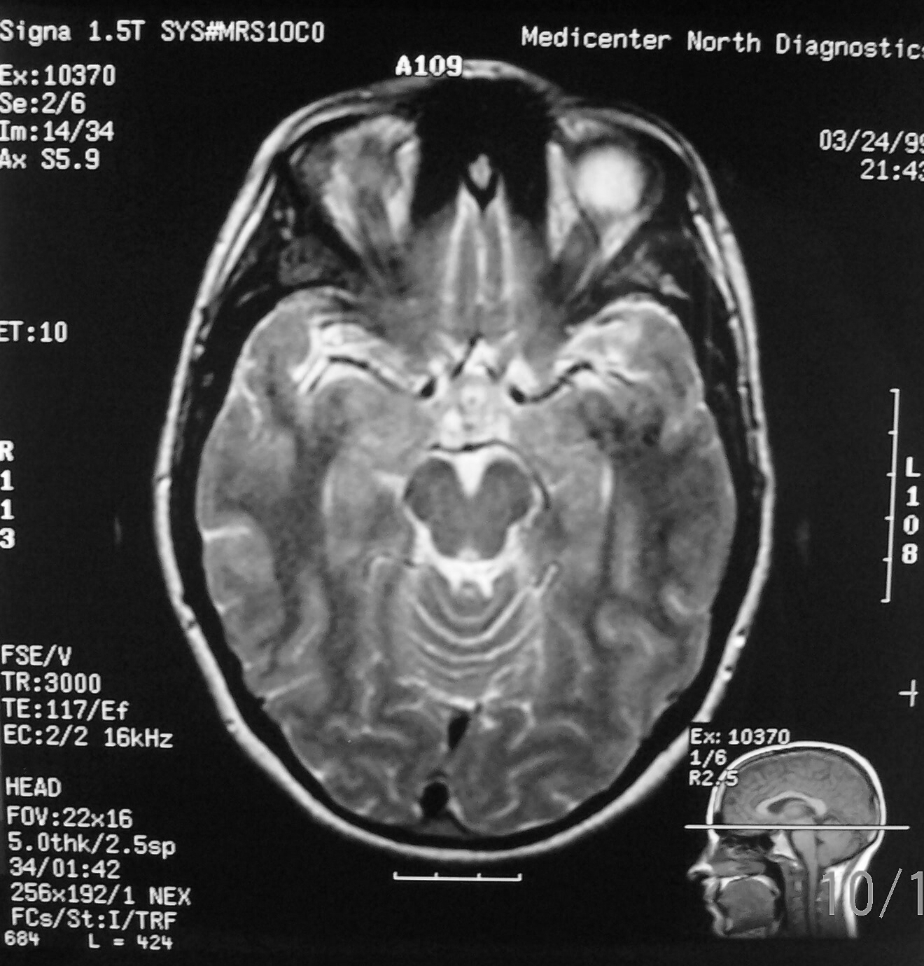
Axial – T2 Weighting
Chiasmatic Cistern
Cerebral Aqueduct
Interpeduncular Cistern
Superior Cistern

Slide 25
Axial – T2 Weighting
Optic Chiasm
Infundibulum
Cerebral Peduncle
Corpora Quadrigemina
Cerebellar Vermis

Slide 26
Axial – T2 Weighting
Anterior Cerebral Artery
Middle Cerebral Artery
Straight Sinus
Posterior Cerebral Artery
Superior Sagittal Sinus

Slide 27
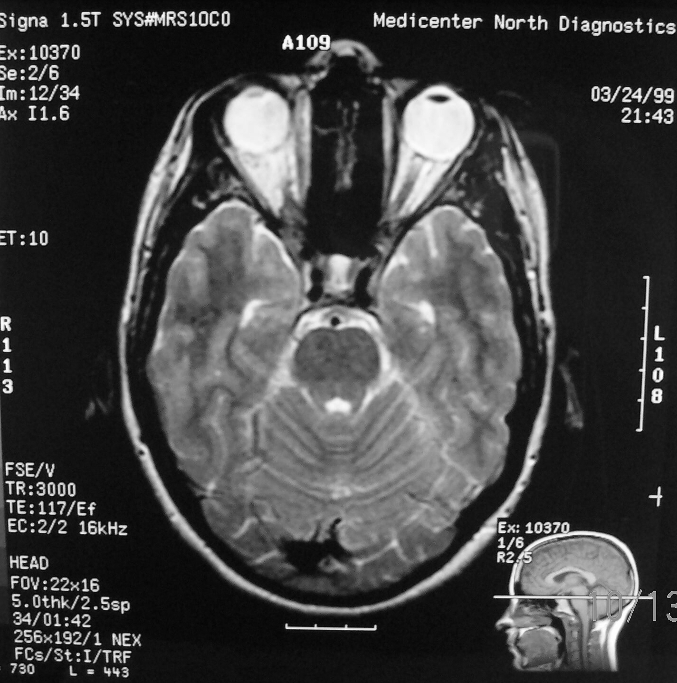
Axial – T2 Weighting
Pontine Cistern
Pons
Fourth Ventricle
Cerebellum

Slide 28
Axial – T2 Weighting
Internal Carotid Artery
Confluence of Sinuses
Basilar Artery

Slide 29
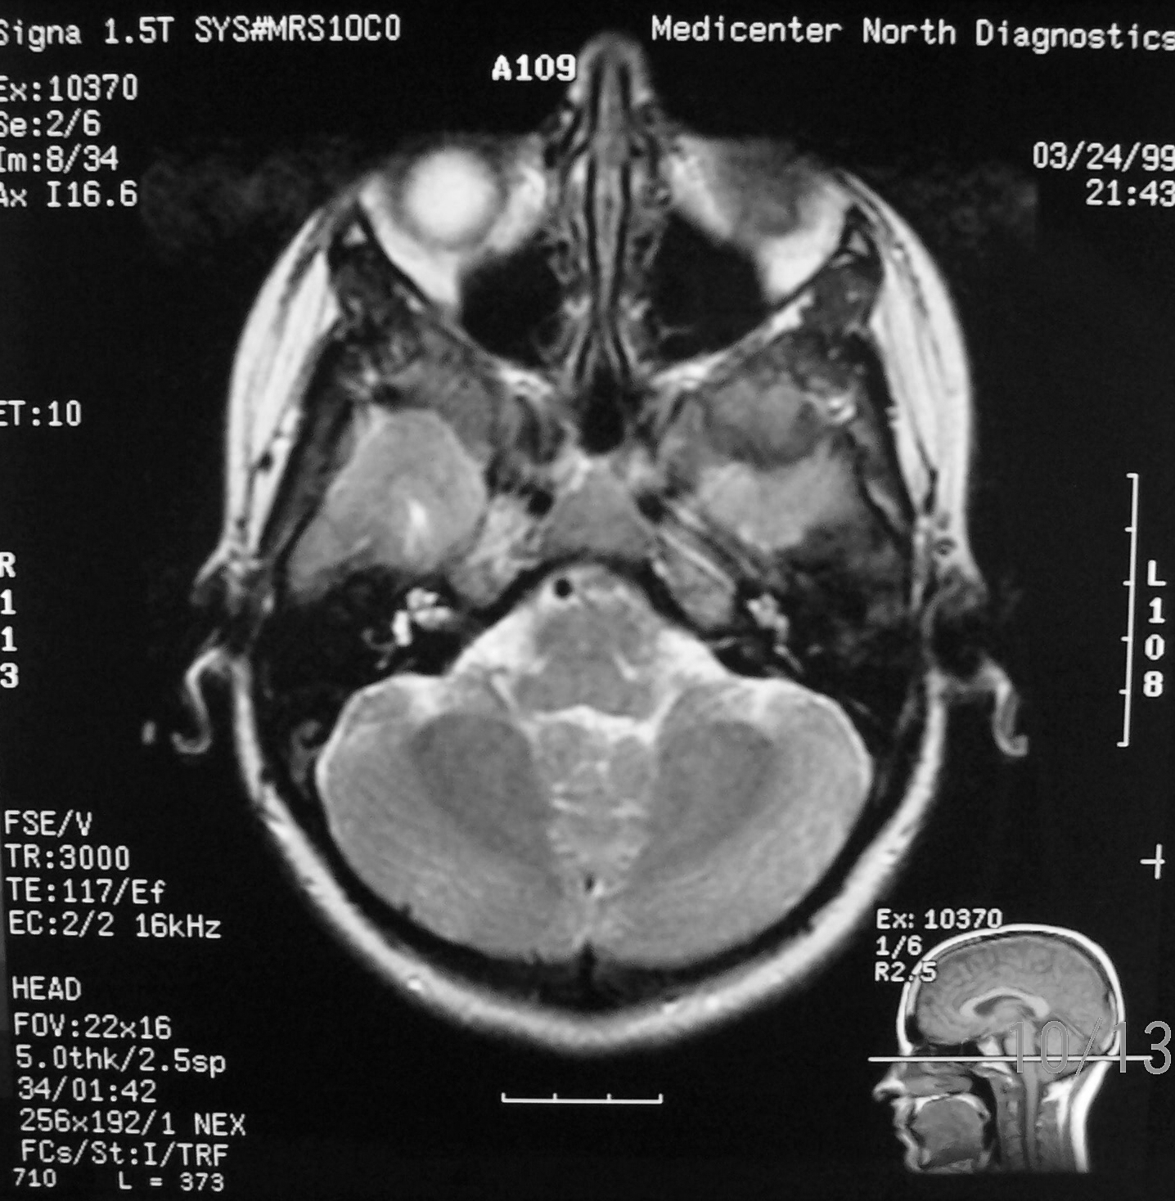
Axial – T2 Weighting
Cerebello-pontine Angle Cistern
Lateral Aperture
Fourth Ventricle

Slide 30
Axial – T2 Weighting
Basilar Artery
Medulla Oblongata
Pons
Cerebellum

Slide 31
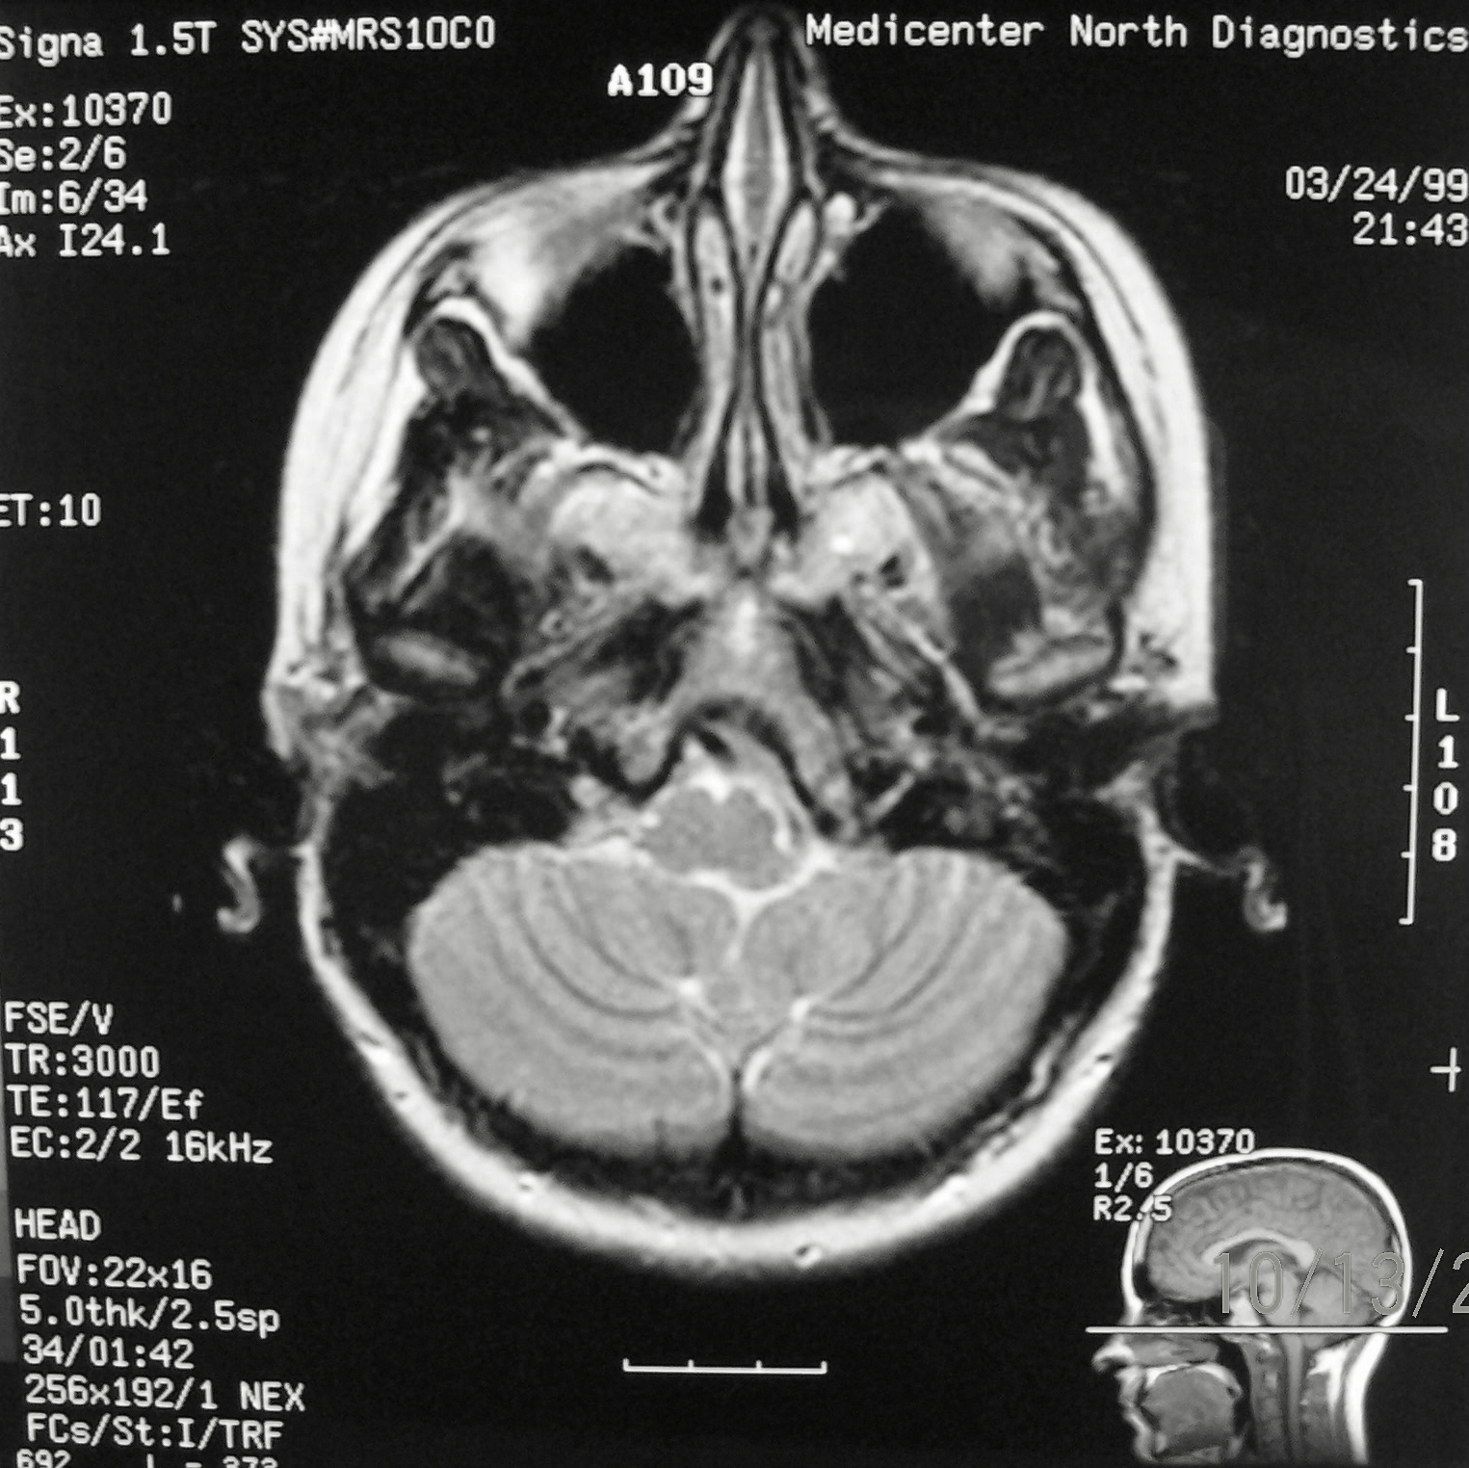
Axial – T2 Weighting
Lateral Aperture
Median Aperture

Slide 32
Axial – T2 Weighting
Medulla Oblongata
Cerebellum

Slide 33
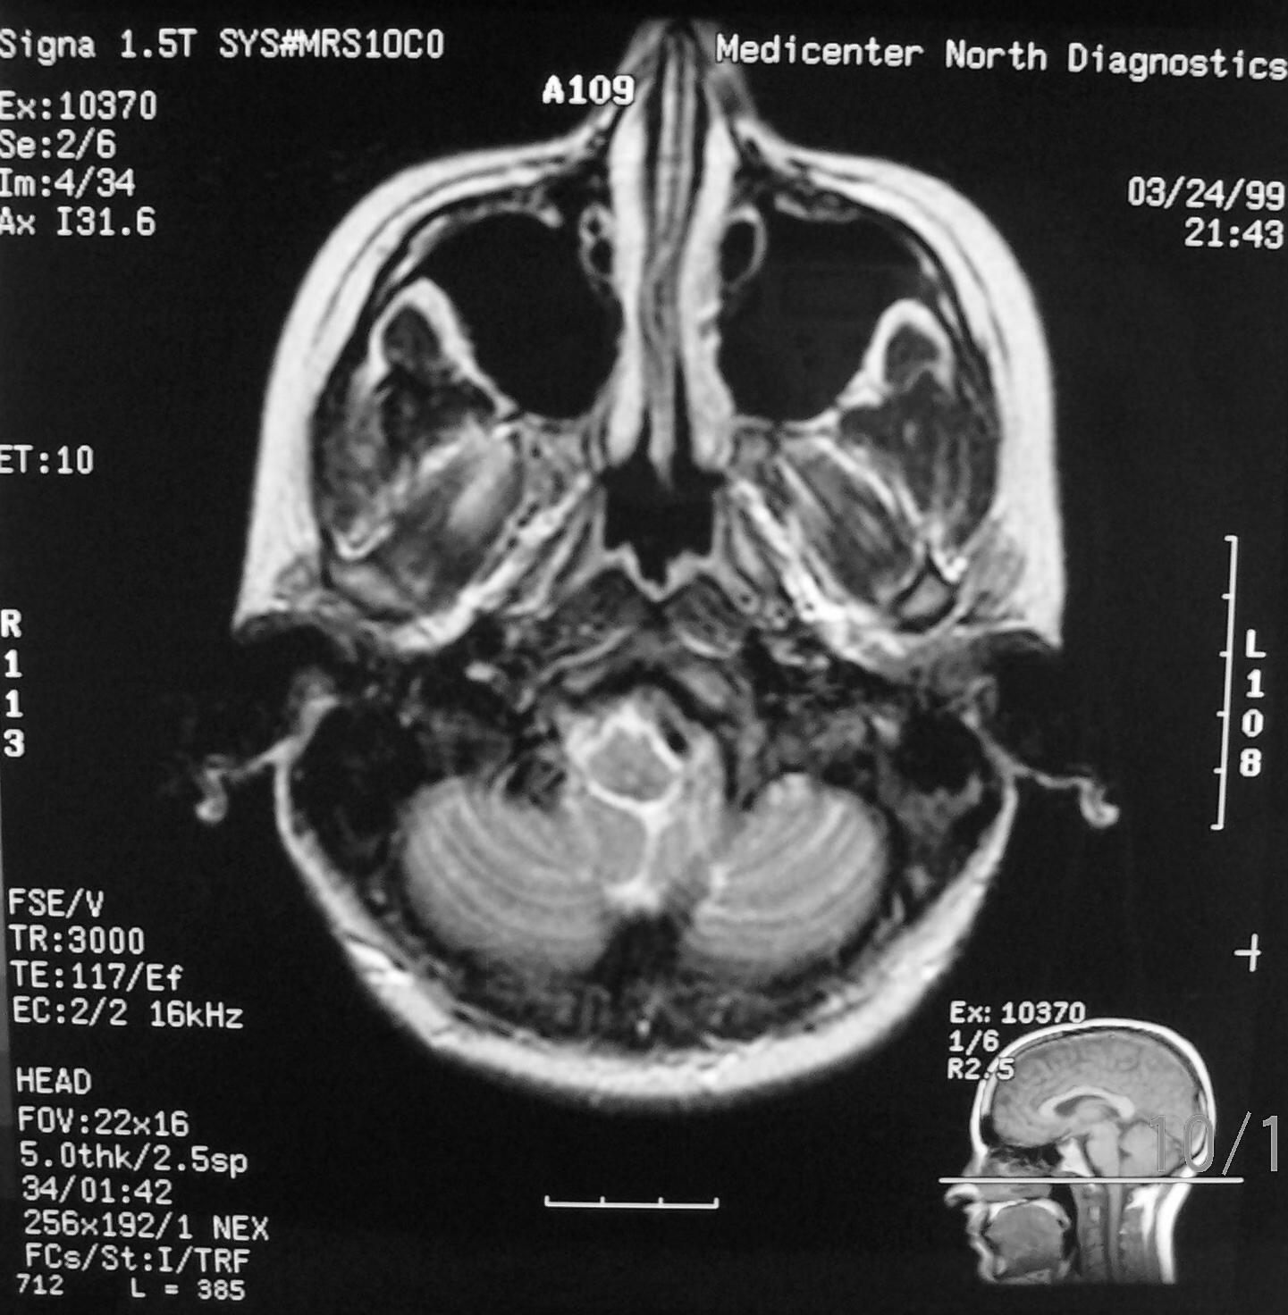
Axial – T2 Weighting
Median Aperture
Cerebellomedullary Cistern

Slide 34
Axial – T2 Weighting
Medulla Oblongata
Cerebellum

Slide 35
Coronal Imaging
Posterior to Anterior aspect

Slide 36
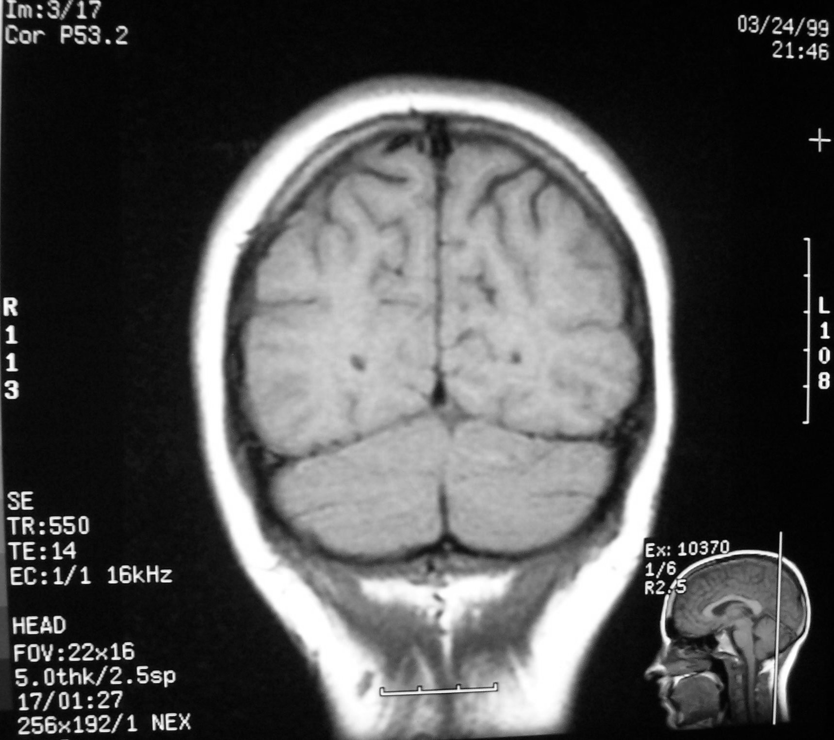
Falx Cerebri (Longitudinal Fissure)
Tentorium Cerebelli

Slide 37
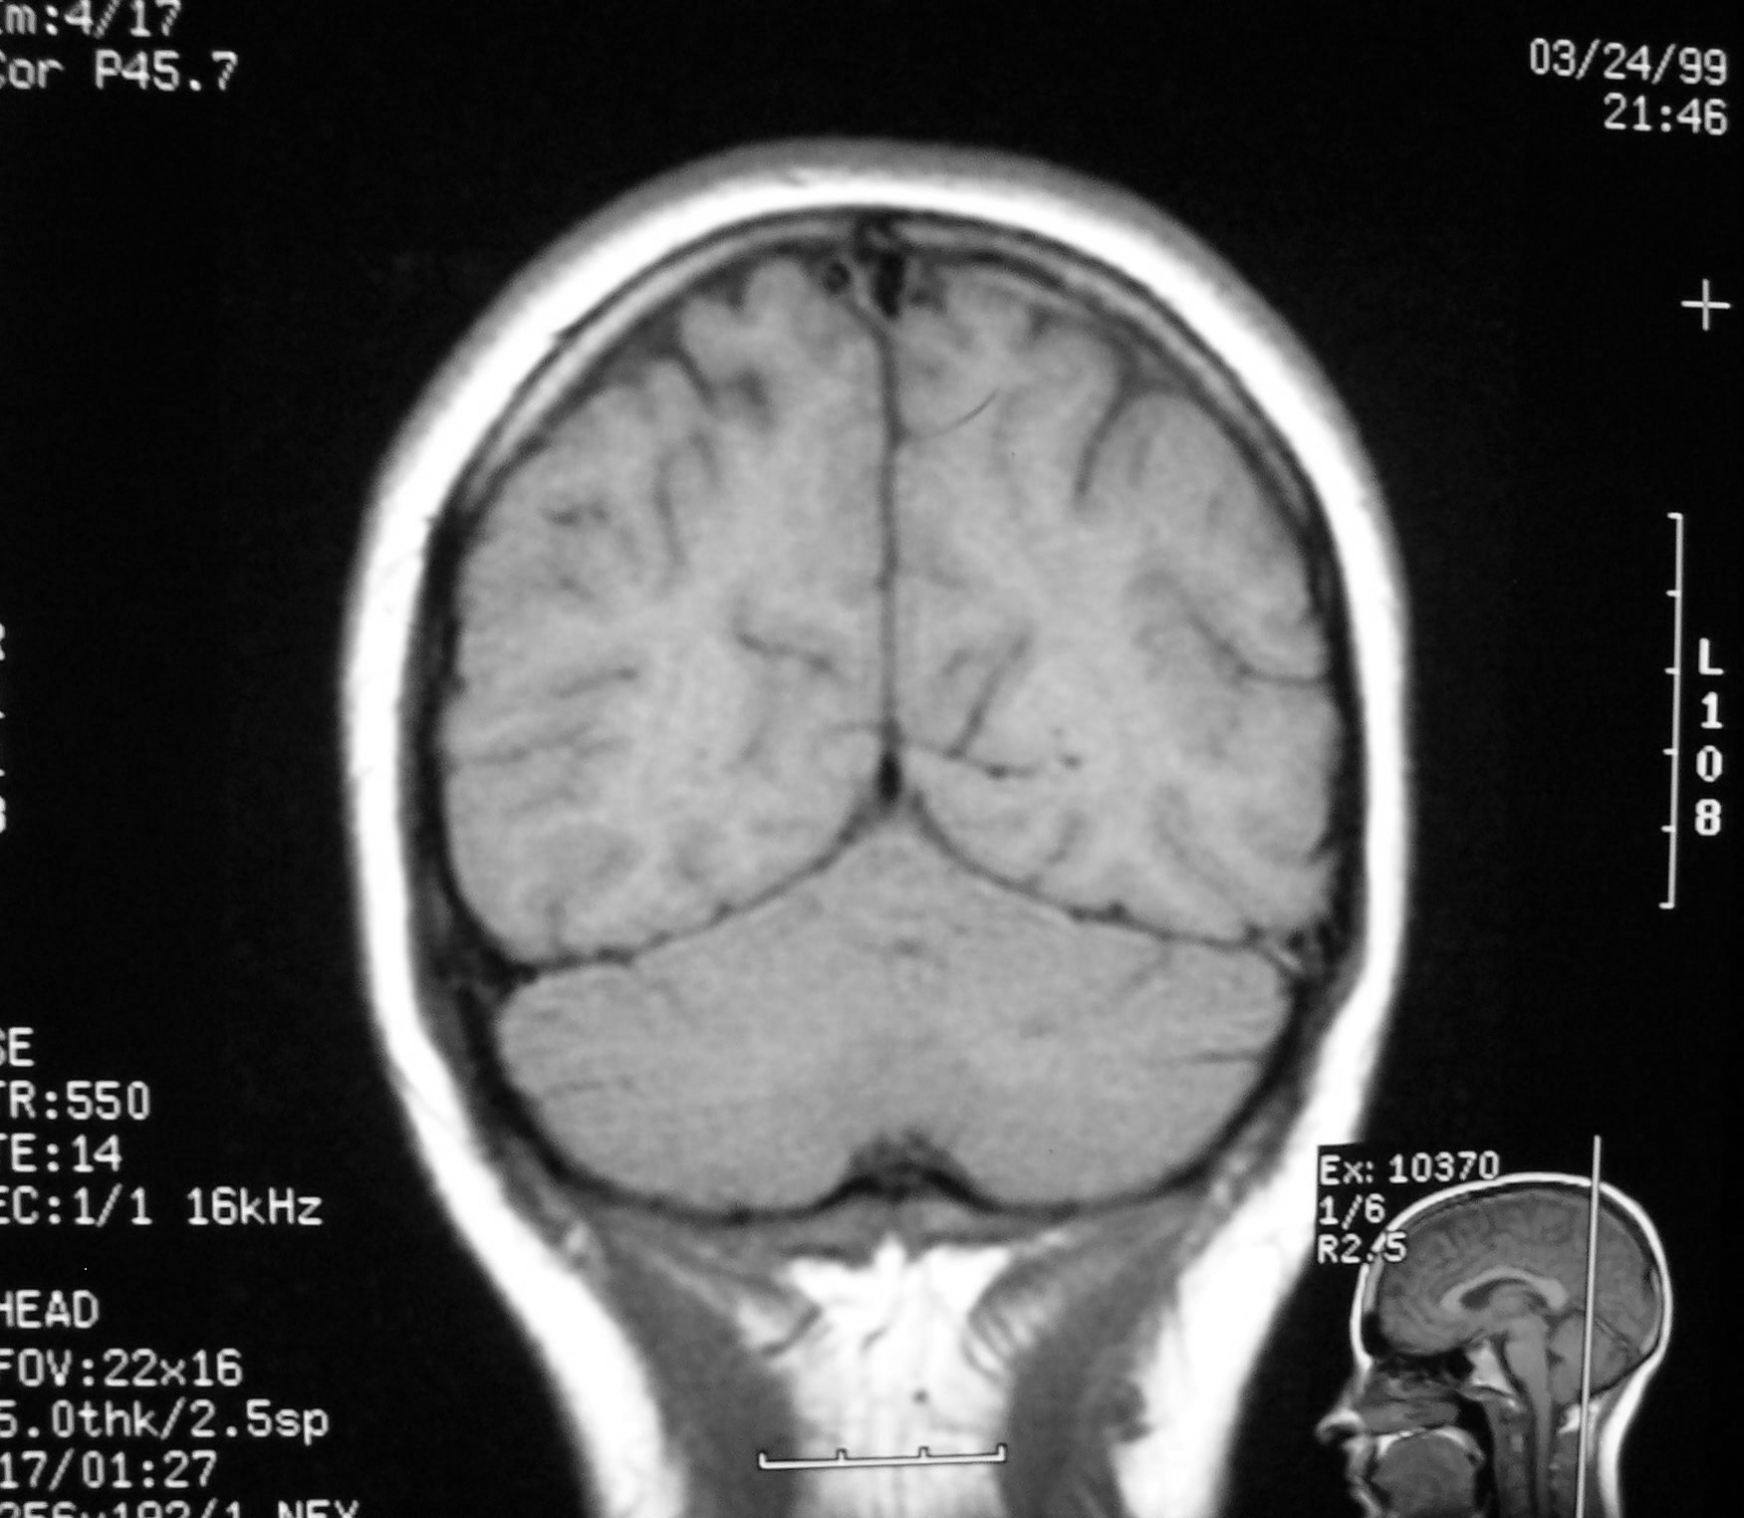
Cerebellum

Slide 38
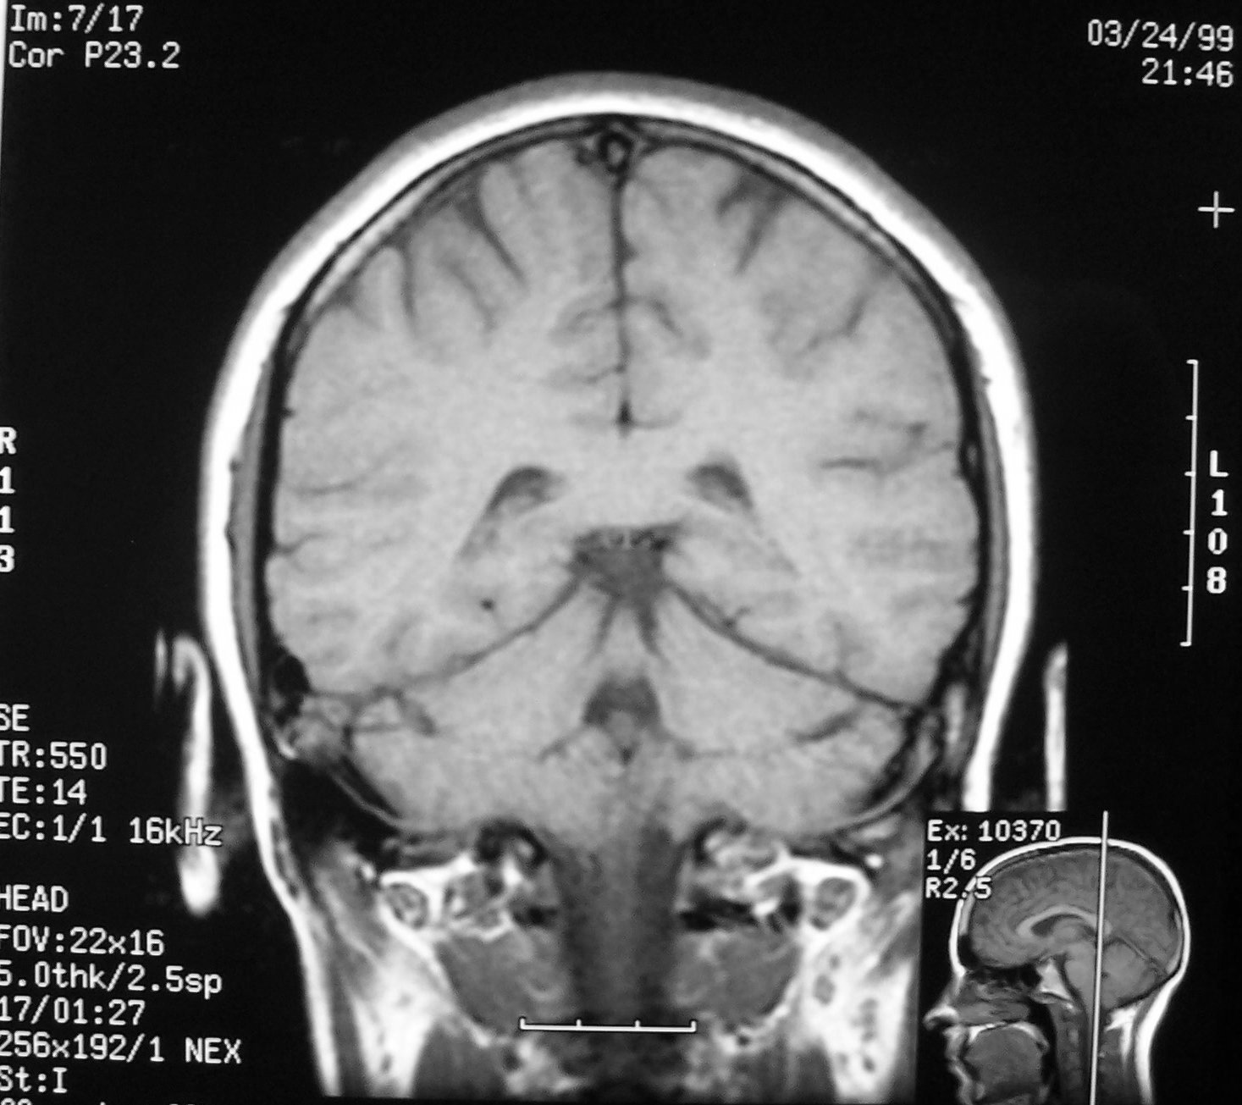
Splenium
Ambient Cistern
Fourth Ventricle

Slide 39
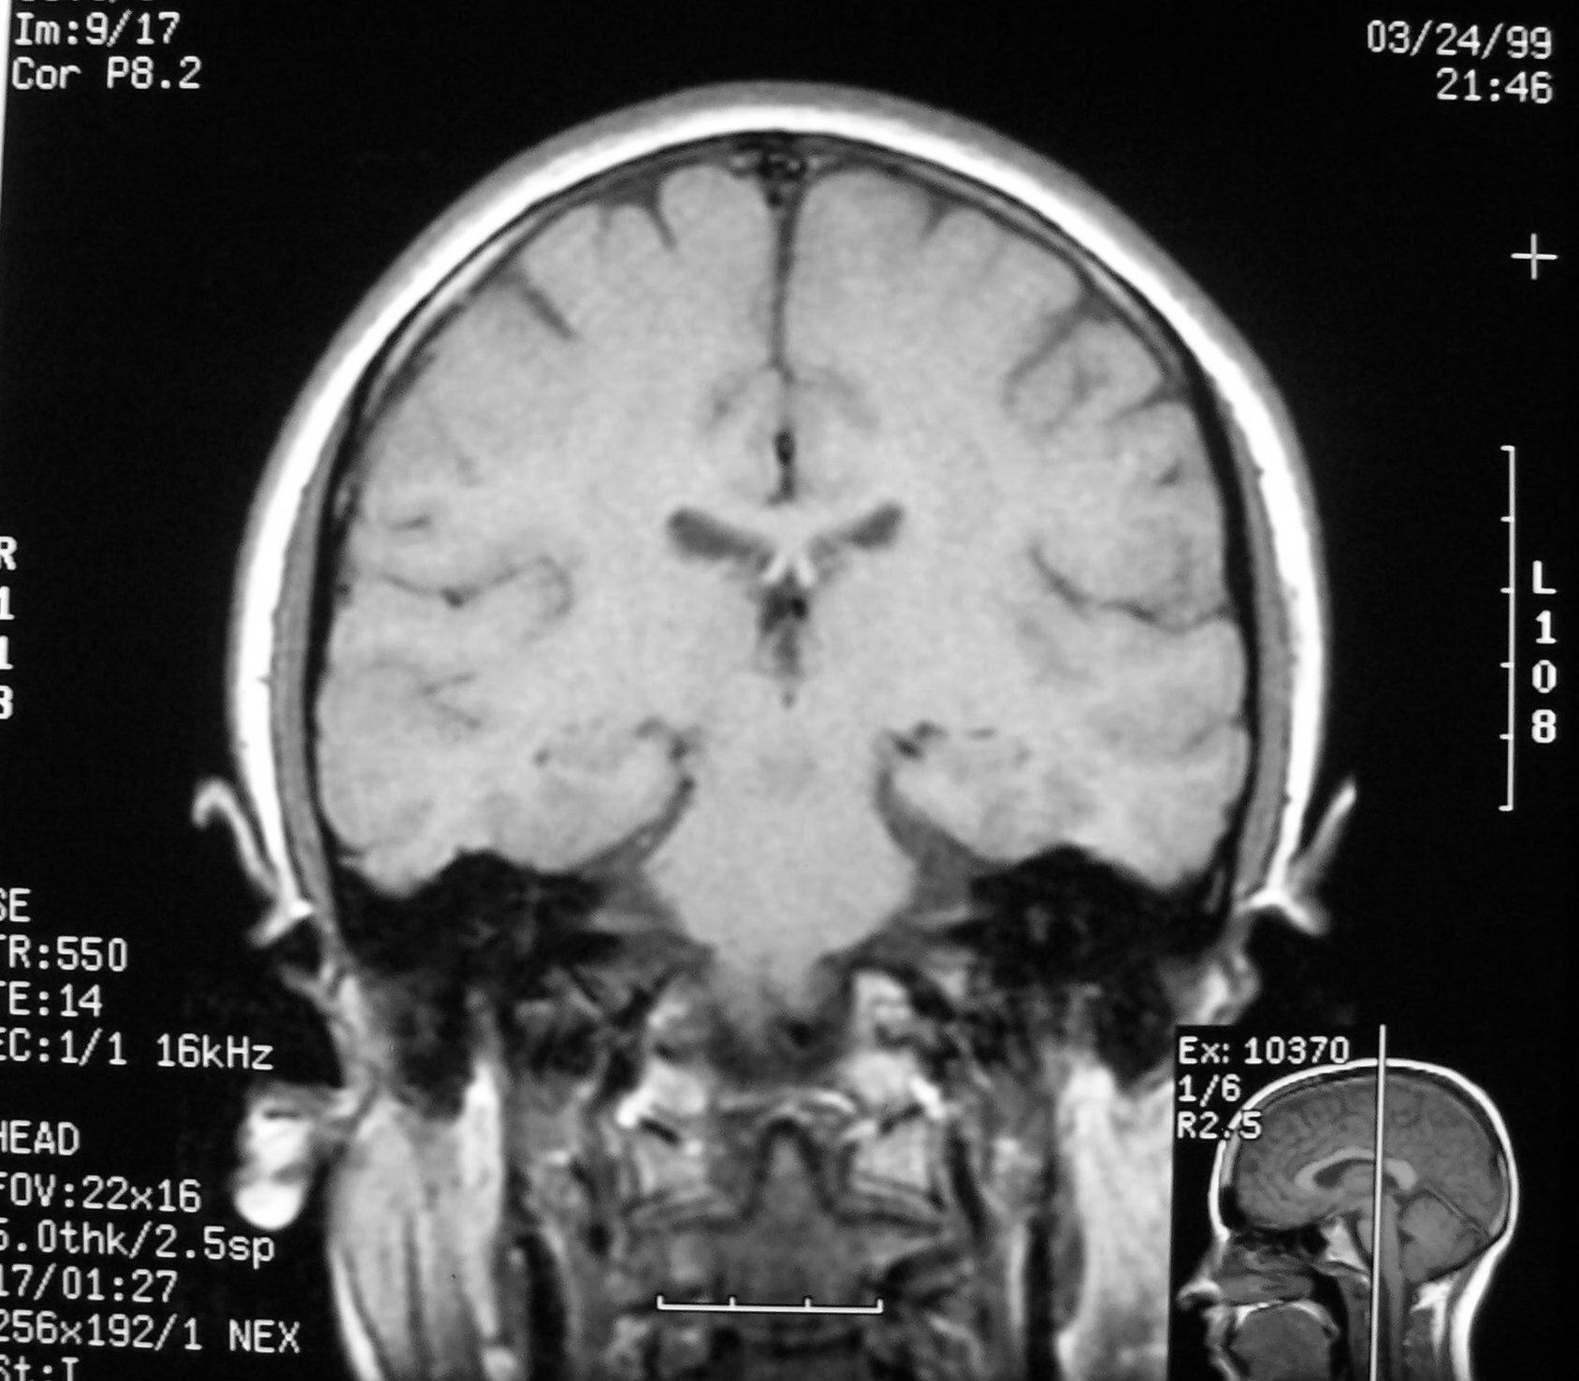
Third Ventricle
Pons

Slide 40
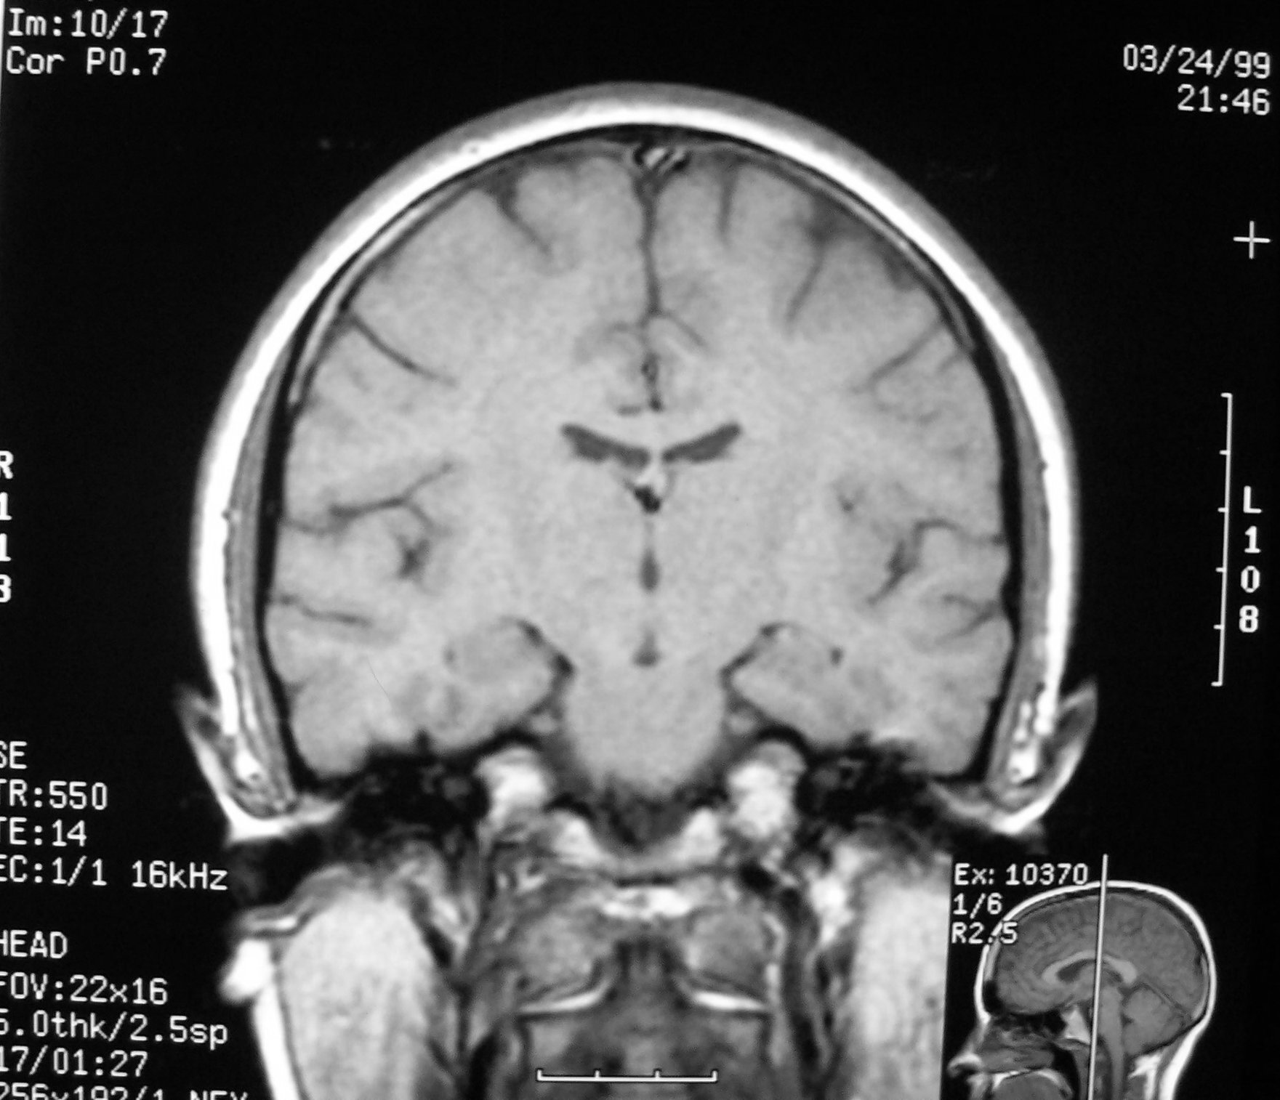
Hippocampus
Pontine Cistern
Thalamus
Pons

Slide 41
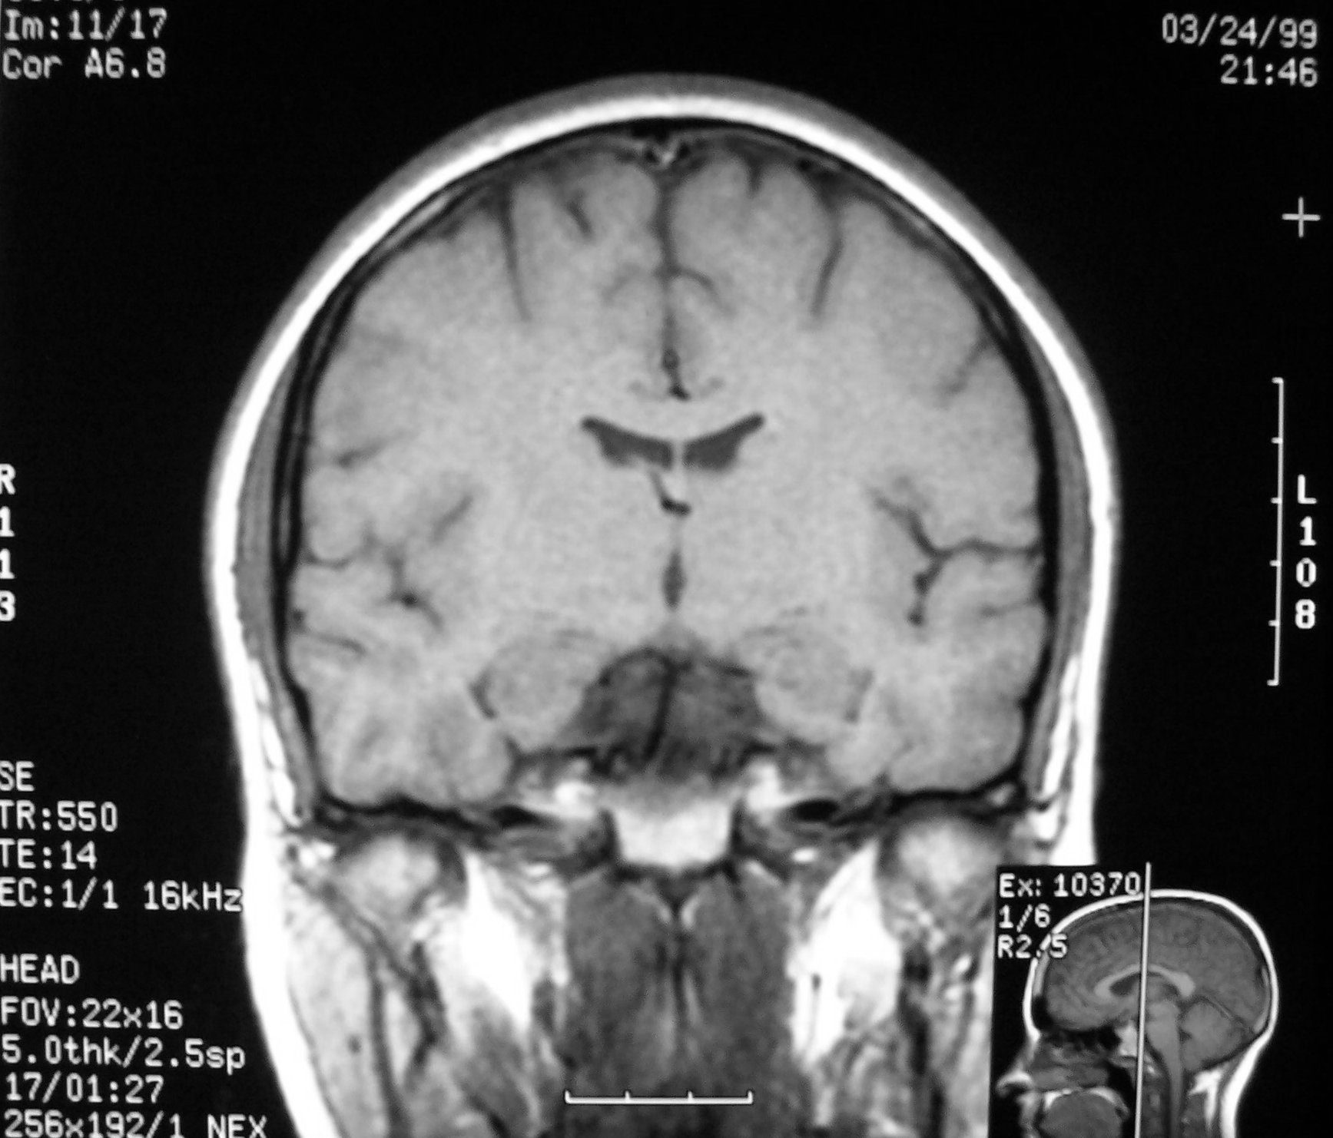
Lateral Ventricle
Third Ventricle
Basilar Artery
Clivus

Slide 42
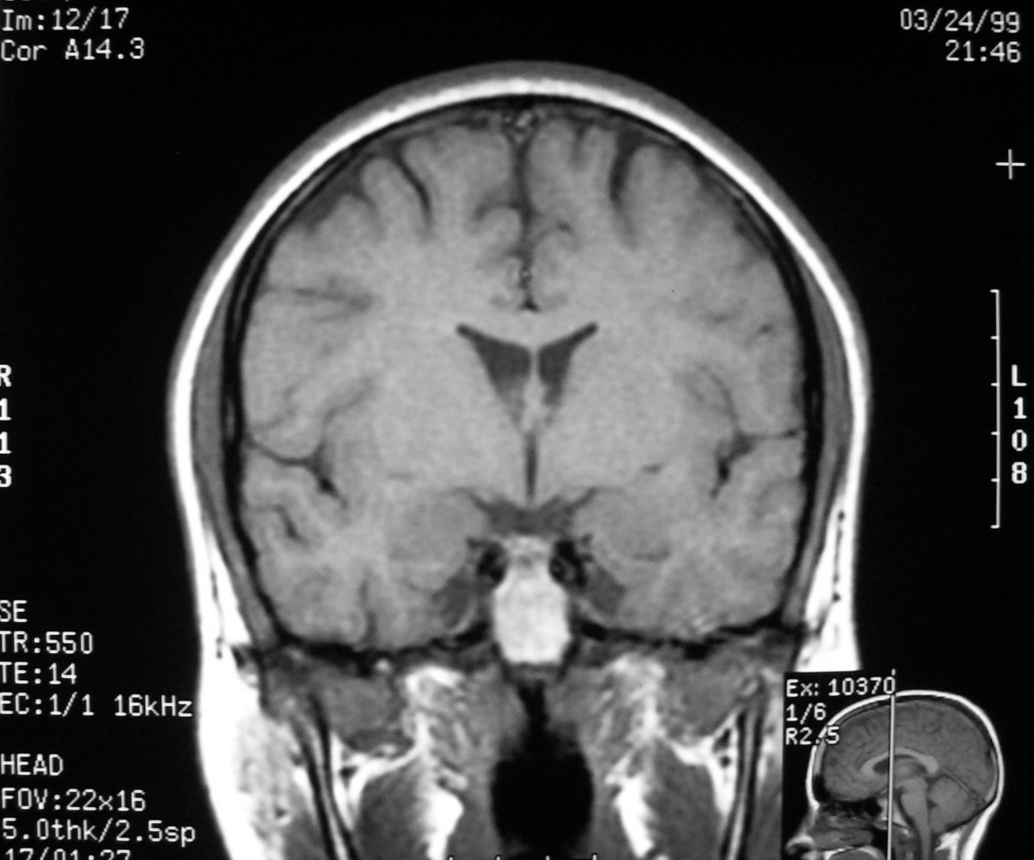
Interventricular Foramen
Sylvian Fissure

Slide 43
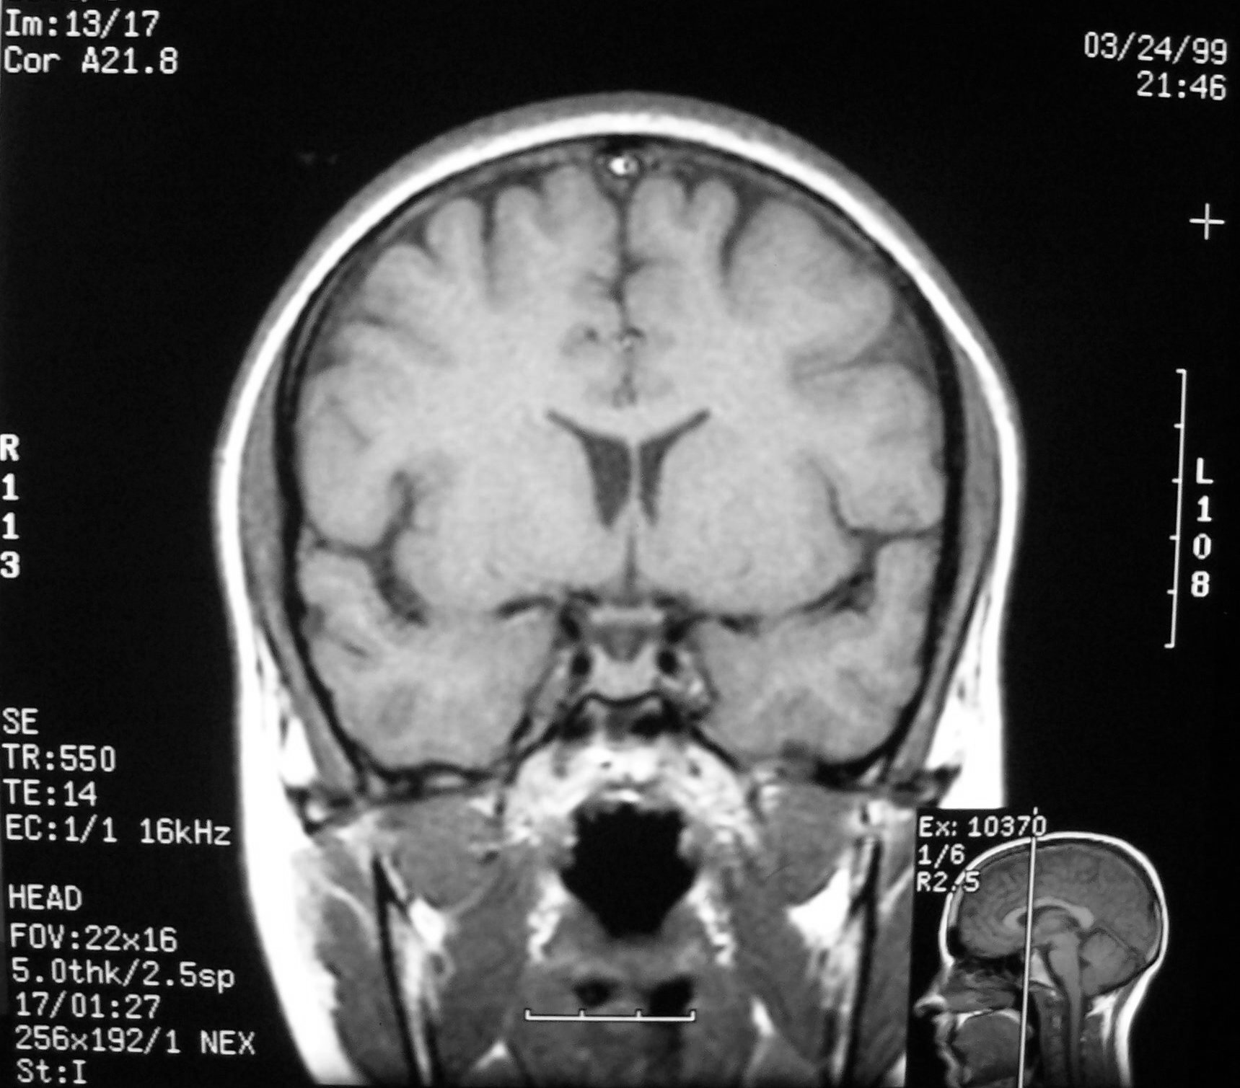
Optic Chiasm
Pituitary

Slide 44
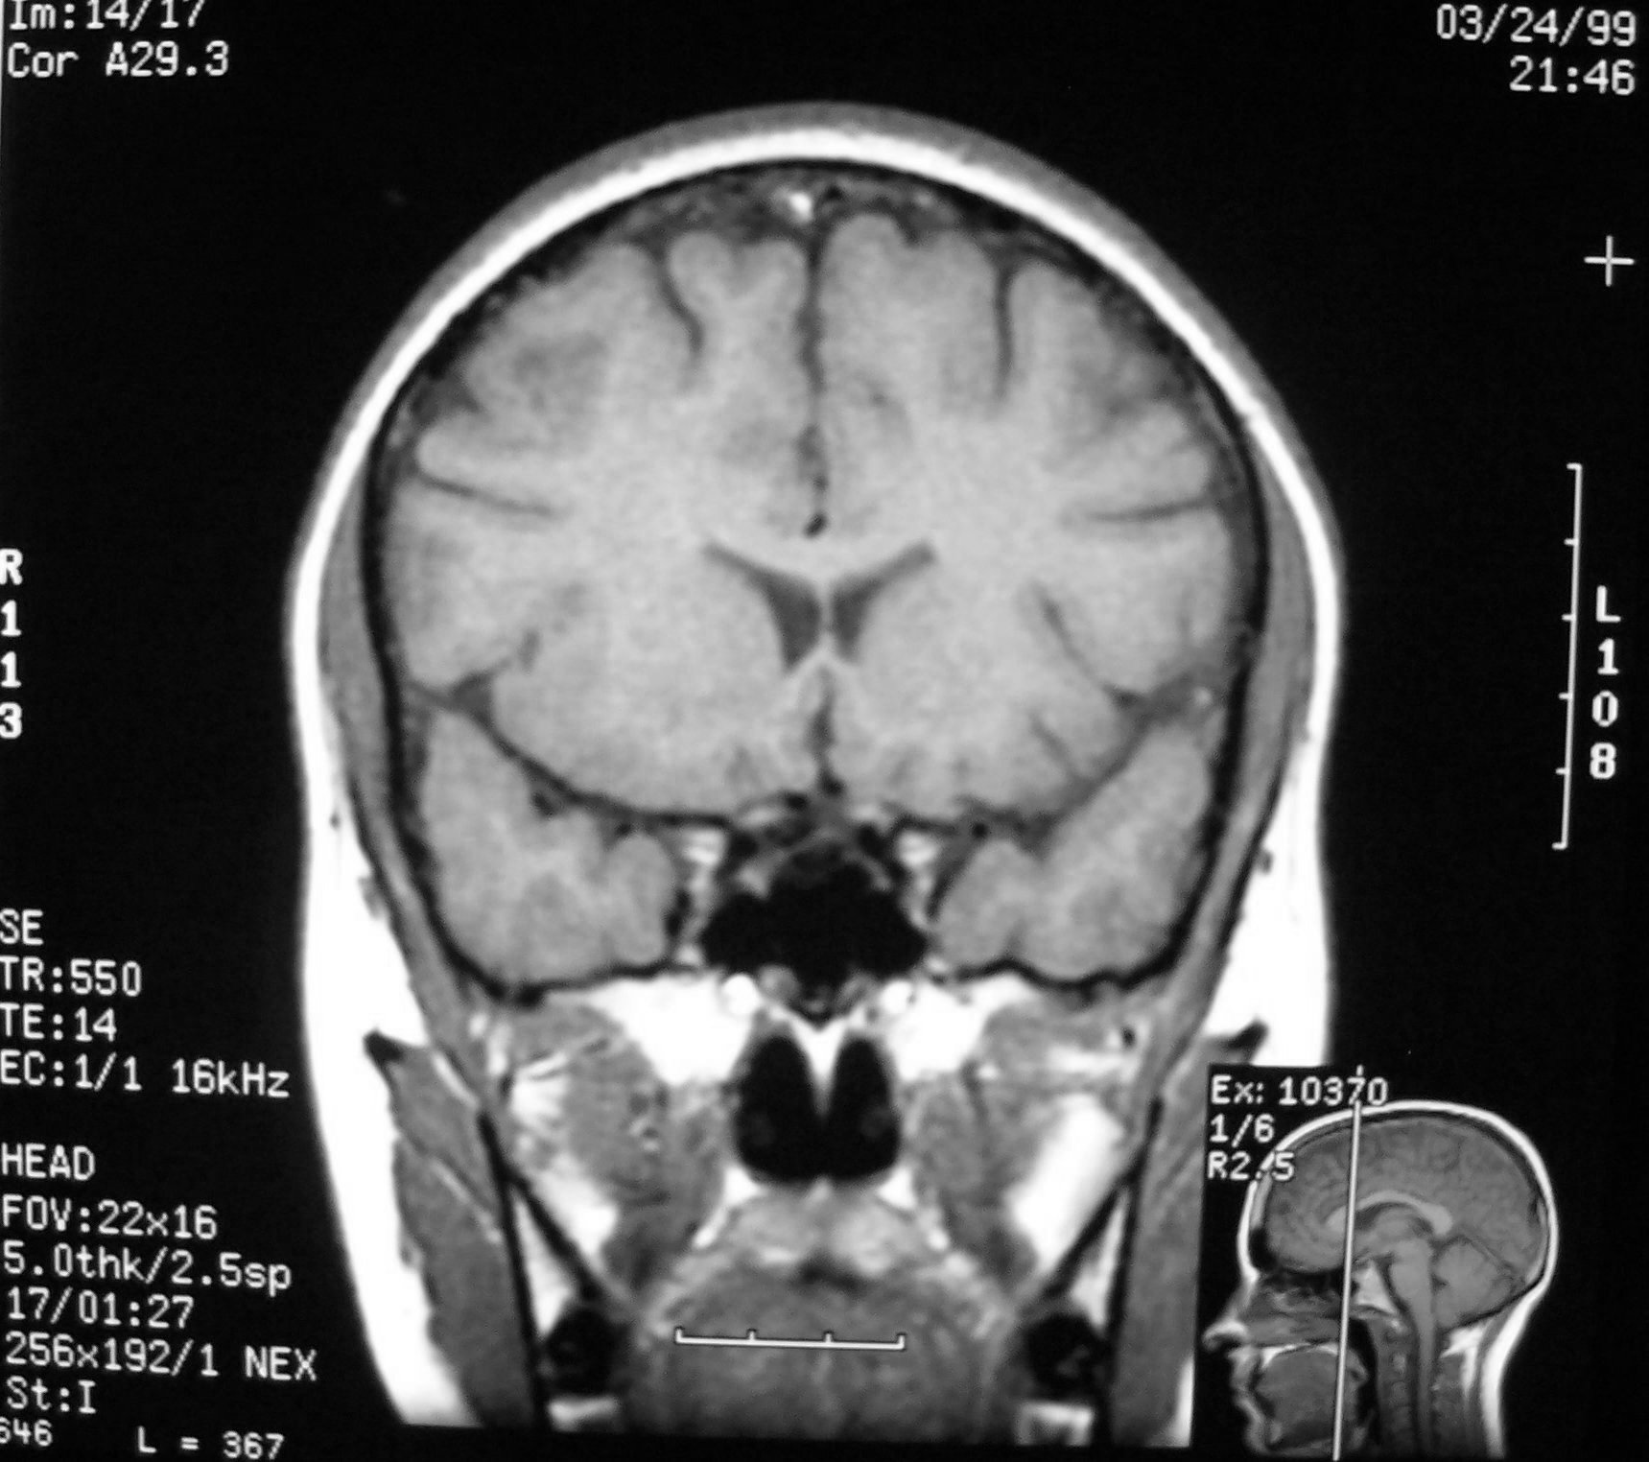
Sphenoid Sinus

Slide 45
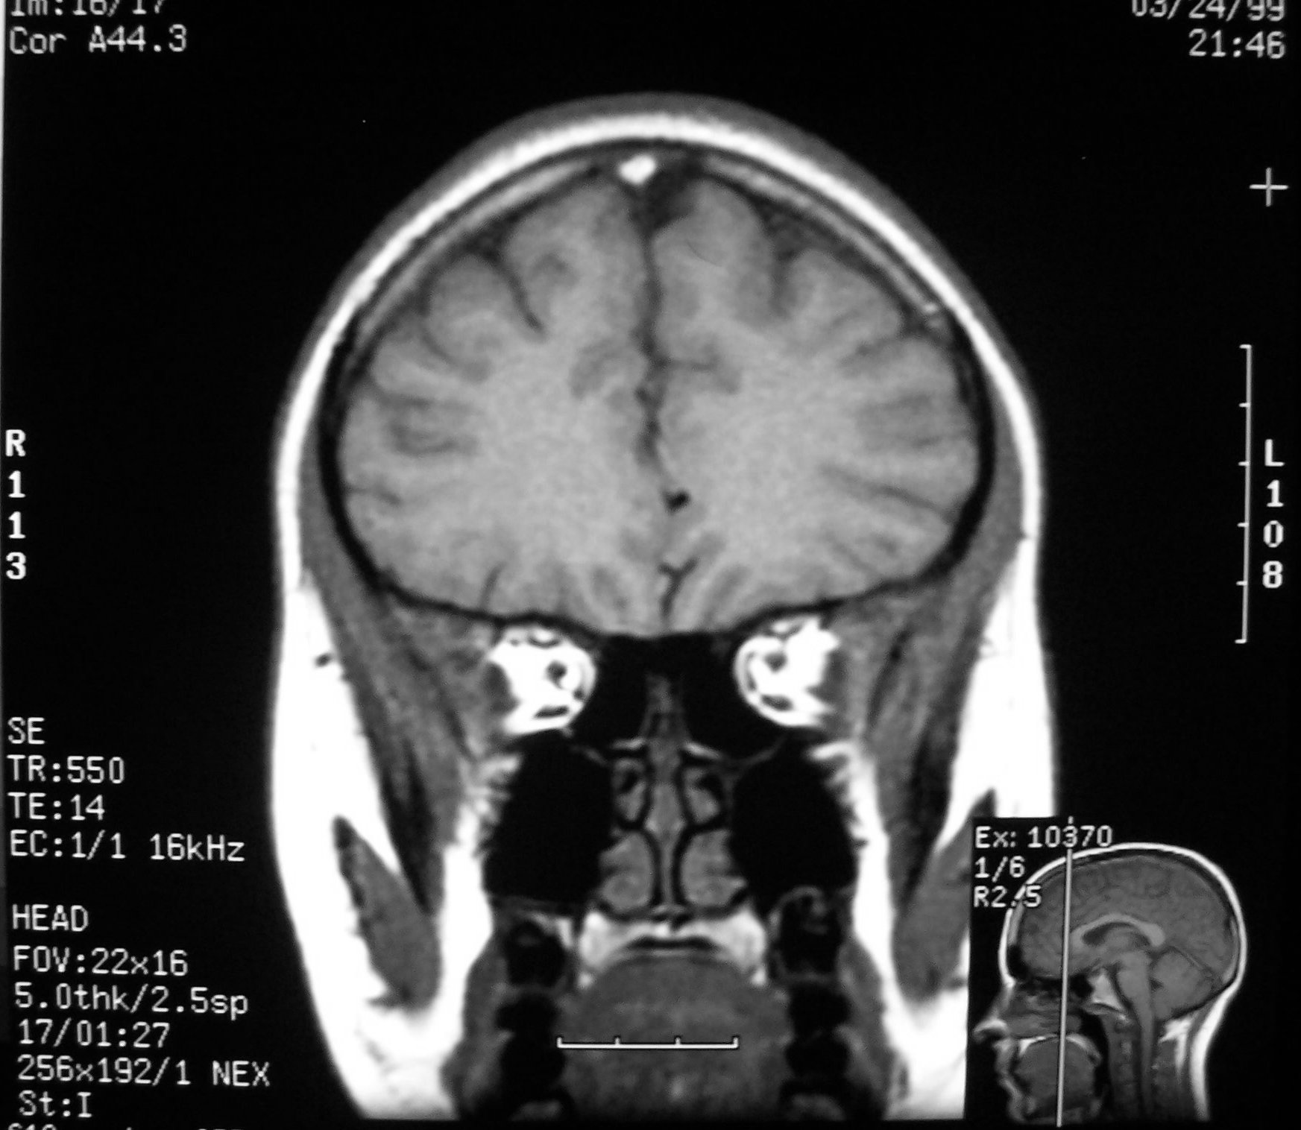
Superior Rectus Muscle
Medial Rectus Muscle
Optic Nerve
Lateral Rectus Muscle
Inferior Rectus Muscle

Slide 46
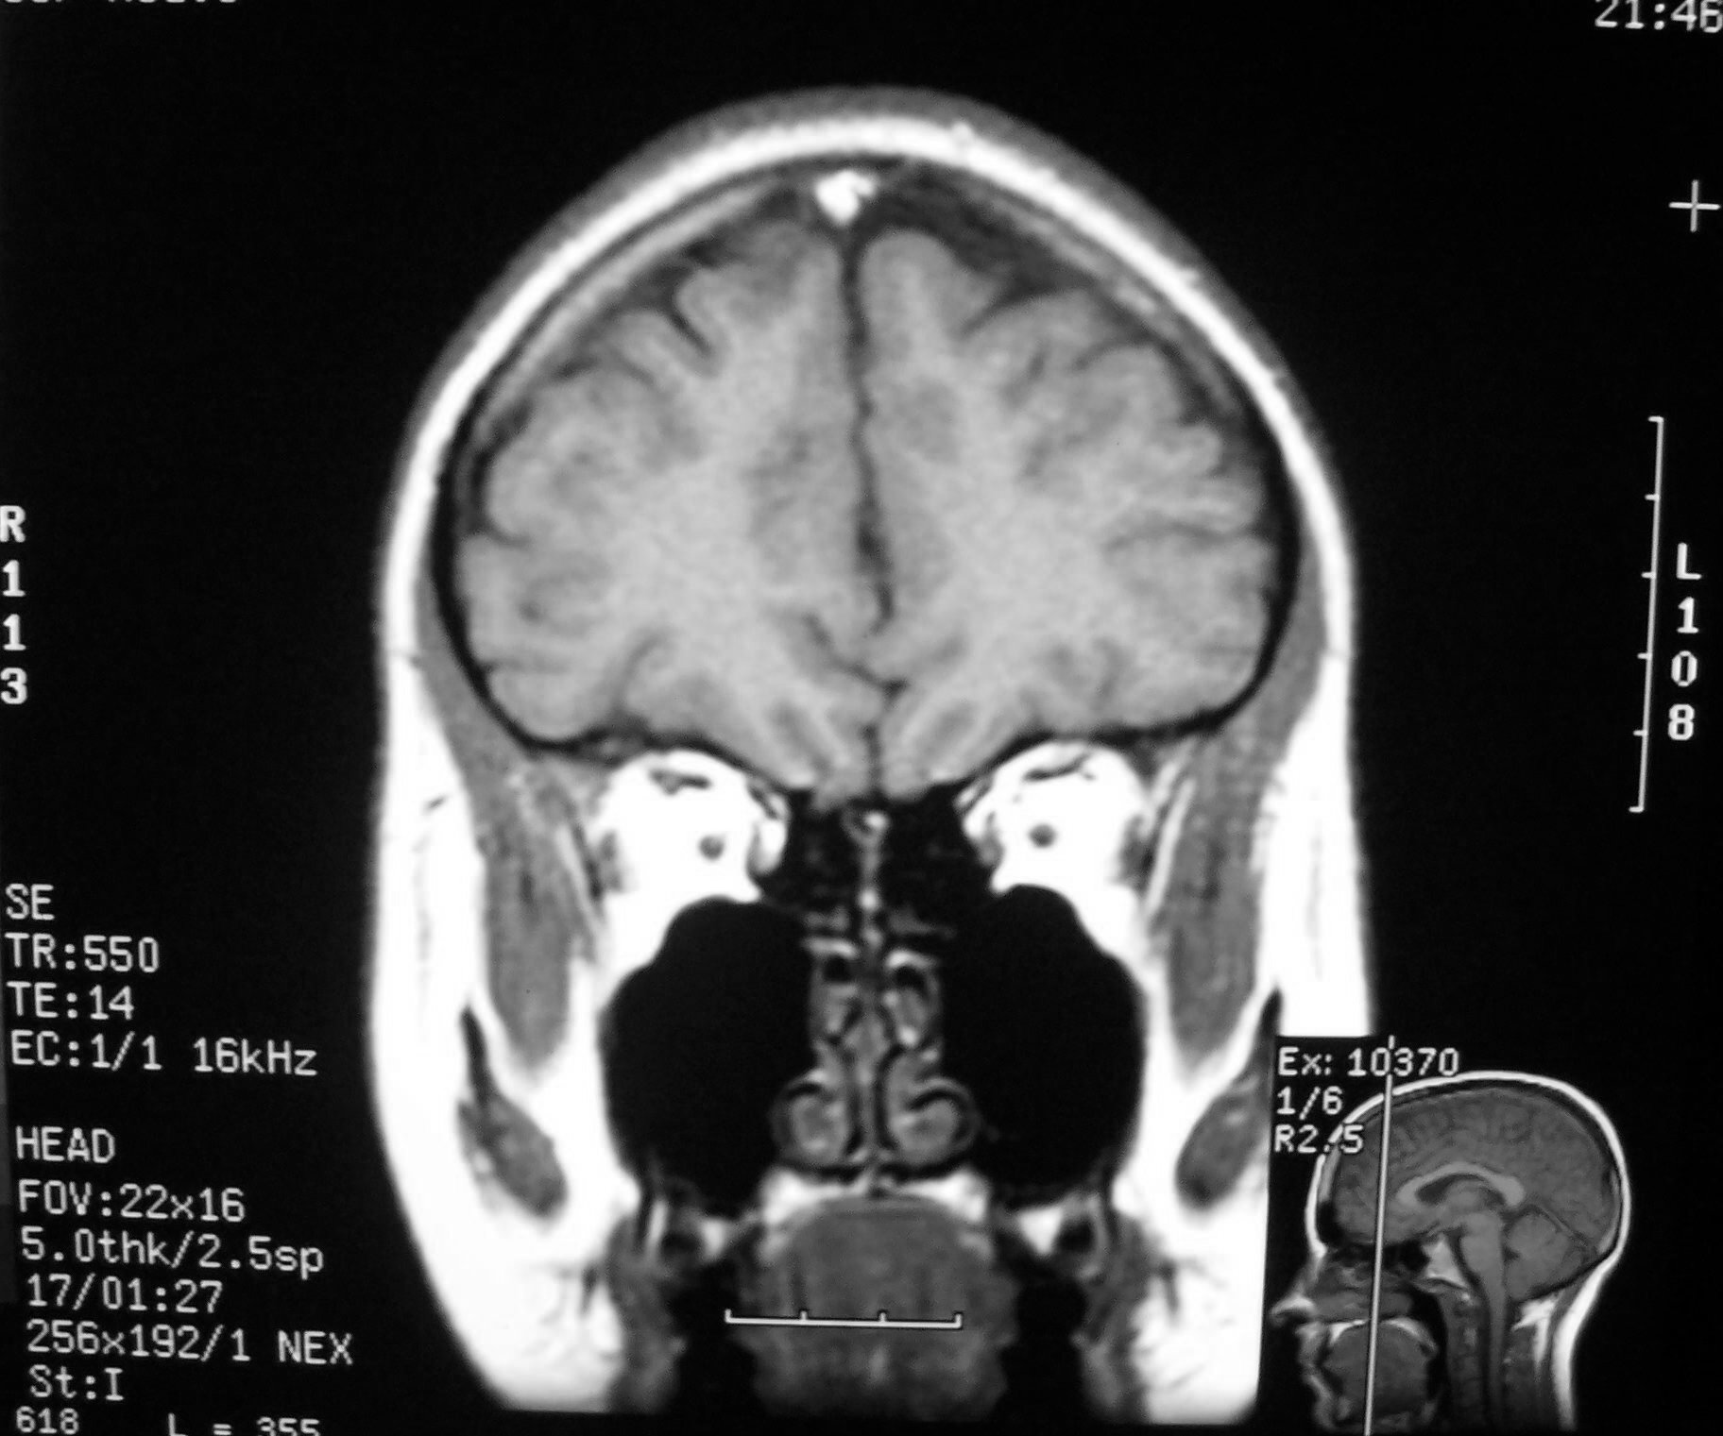
Maxillary Sinus
Inferior Nasal Conchae

Slide 47
Sagittal Imaging
Medial to Lateral aspect

Slide 48
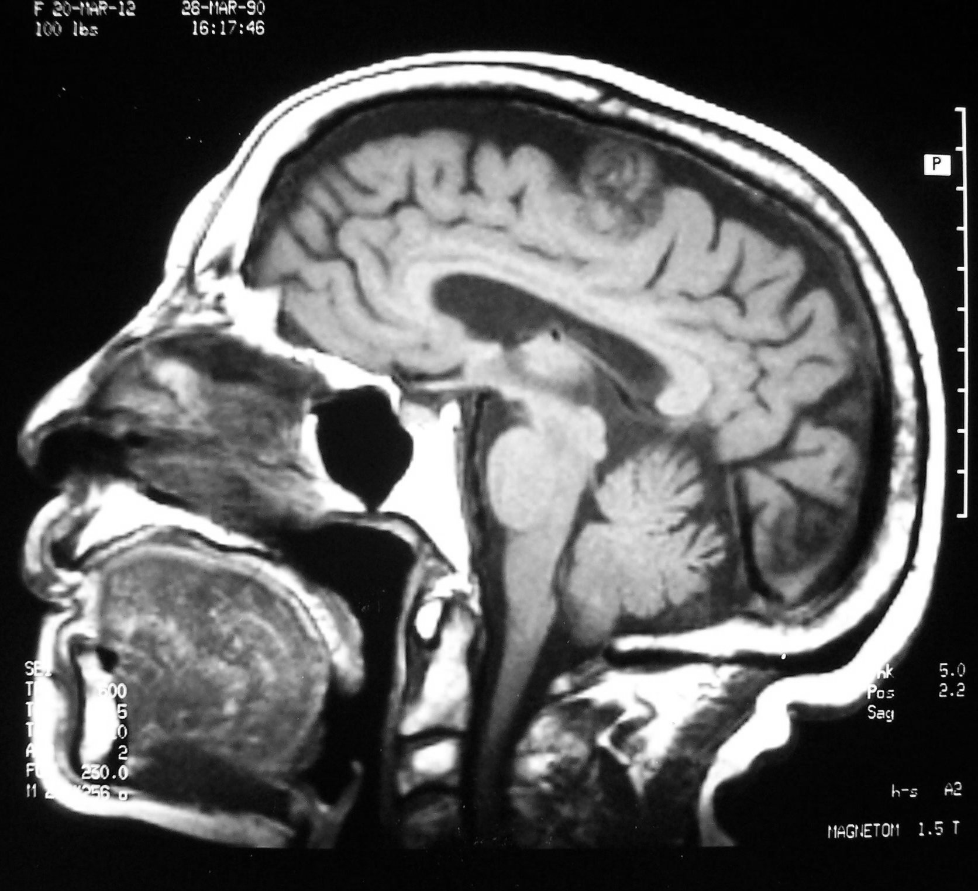
Lateral Ventricles
Midbrain
Optic Chiasm
Pons
Medulla
Cerebellum

Slide 49
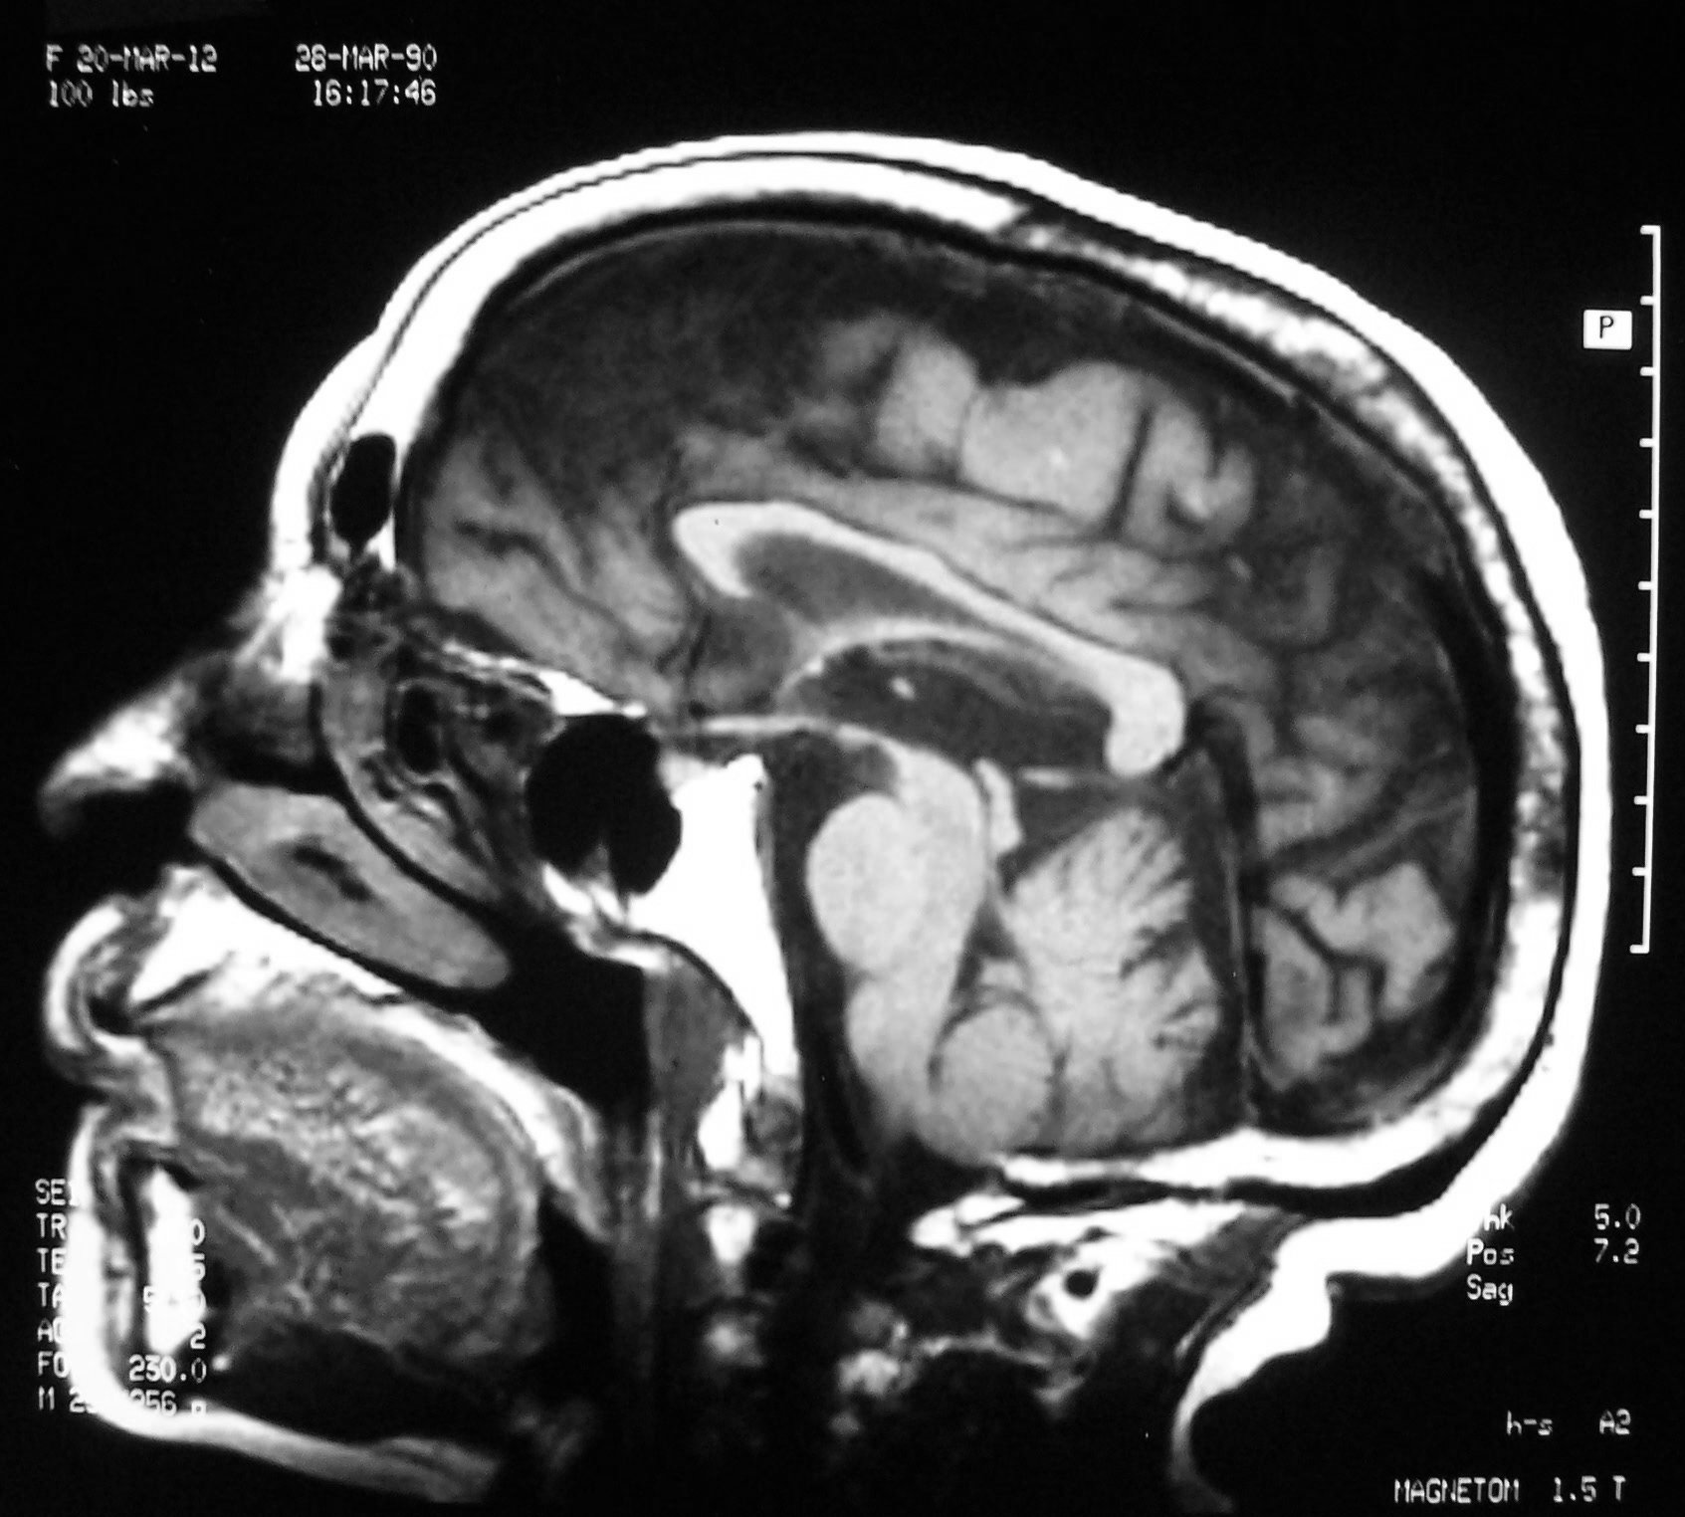
Genu
Splenium
Pontine Cistern
Ambient Cistern
Fourth Ventricle

Slide 50
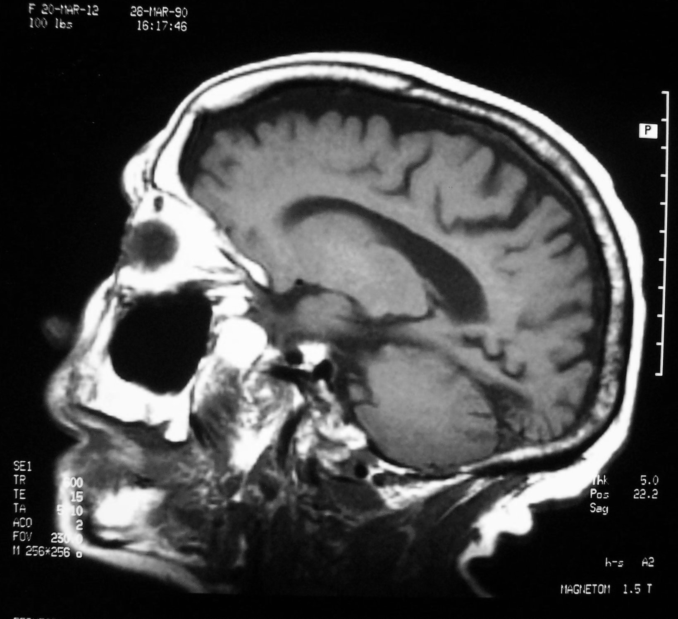
Anterior Horn Lateral Ventricle

Slide 51
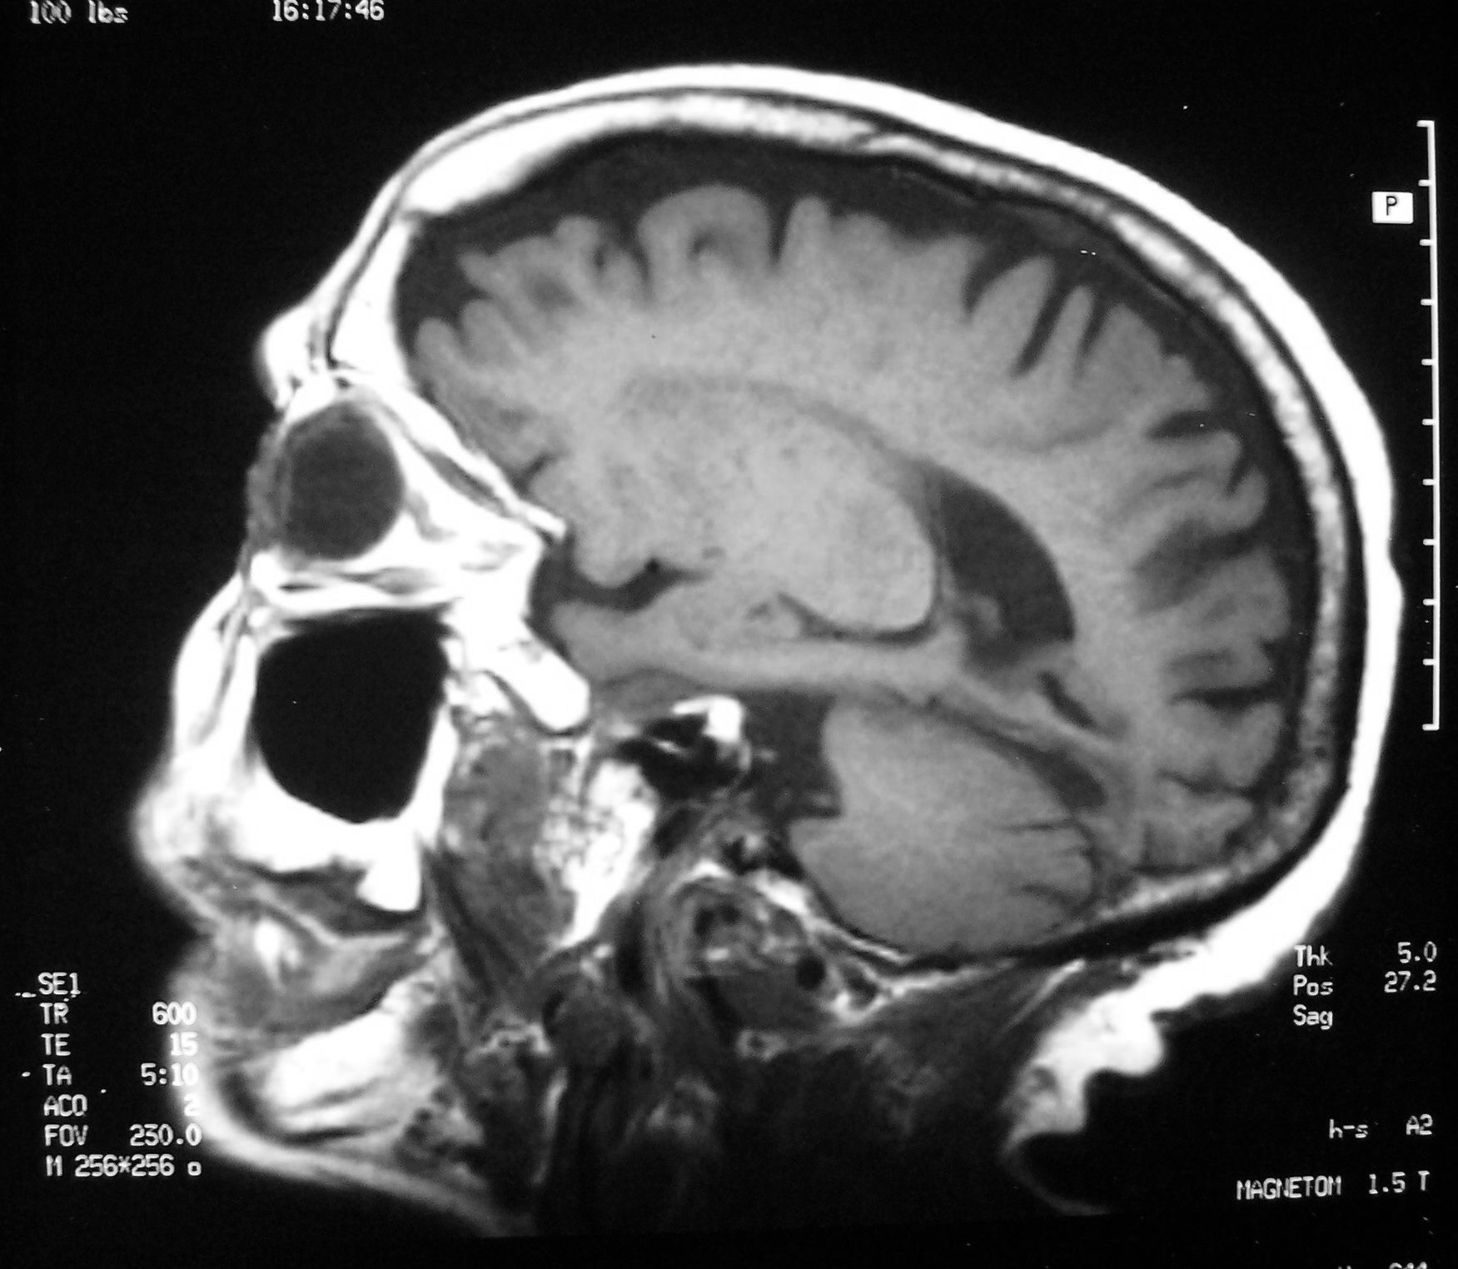
Posterior Horn Lateral Ventricle
Optic Nerve
Maxillary Sinus

Slide 52
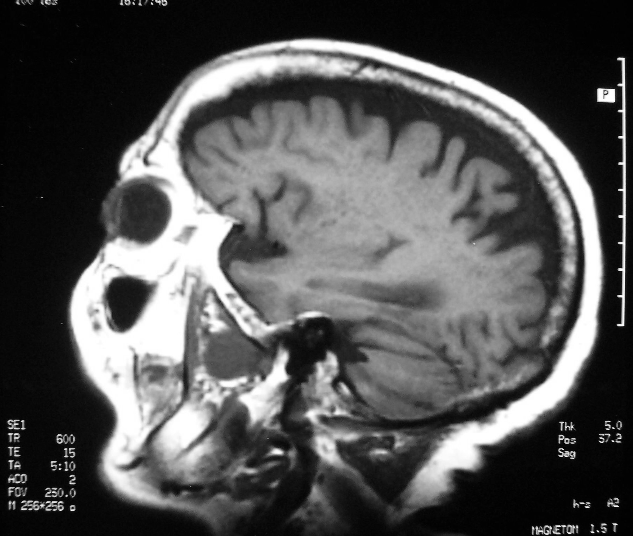
Inferior Horn Lateral Ventricle

Slide 53
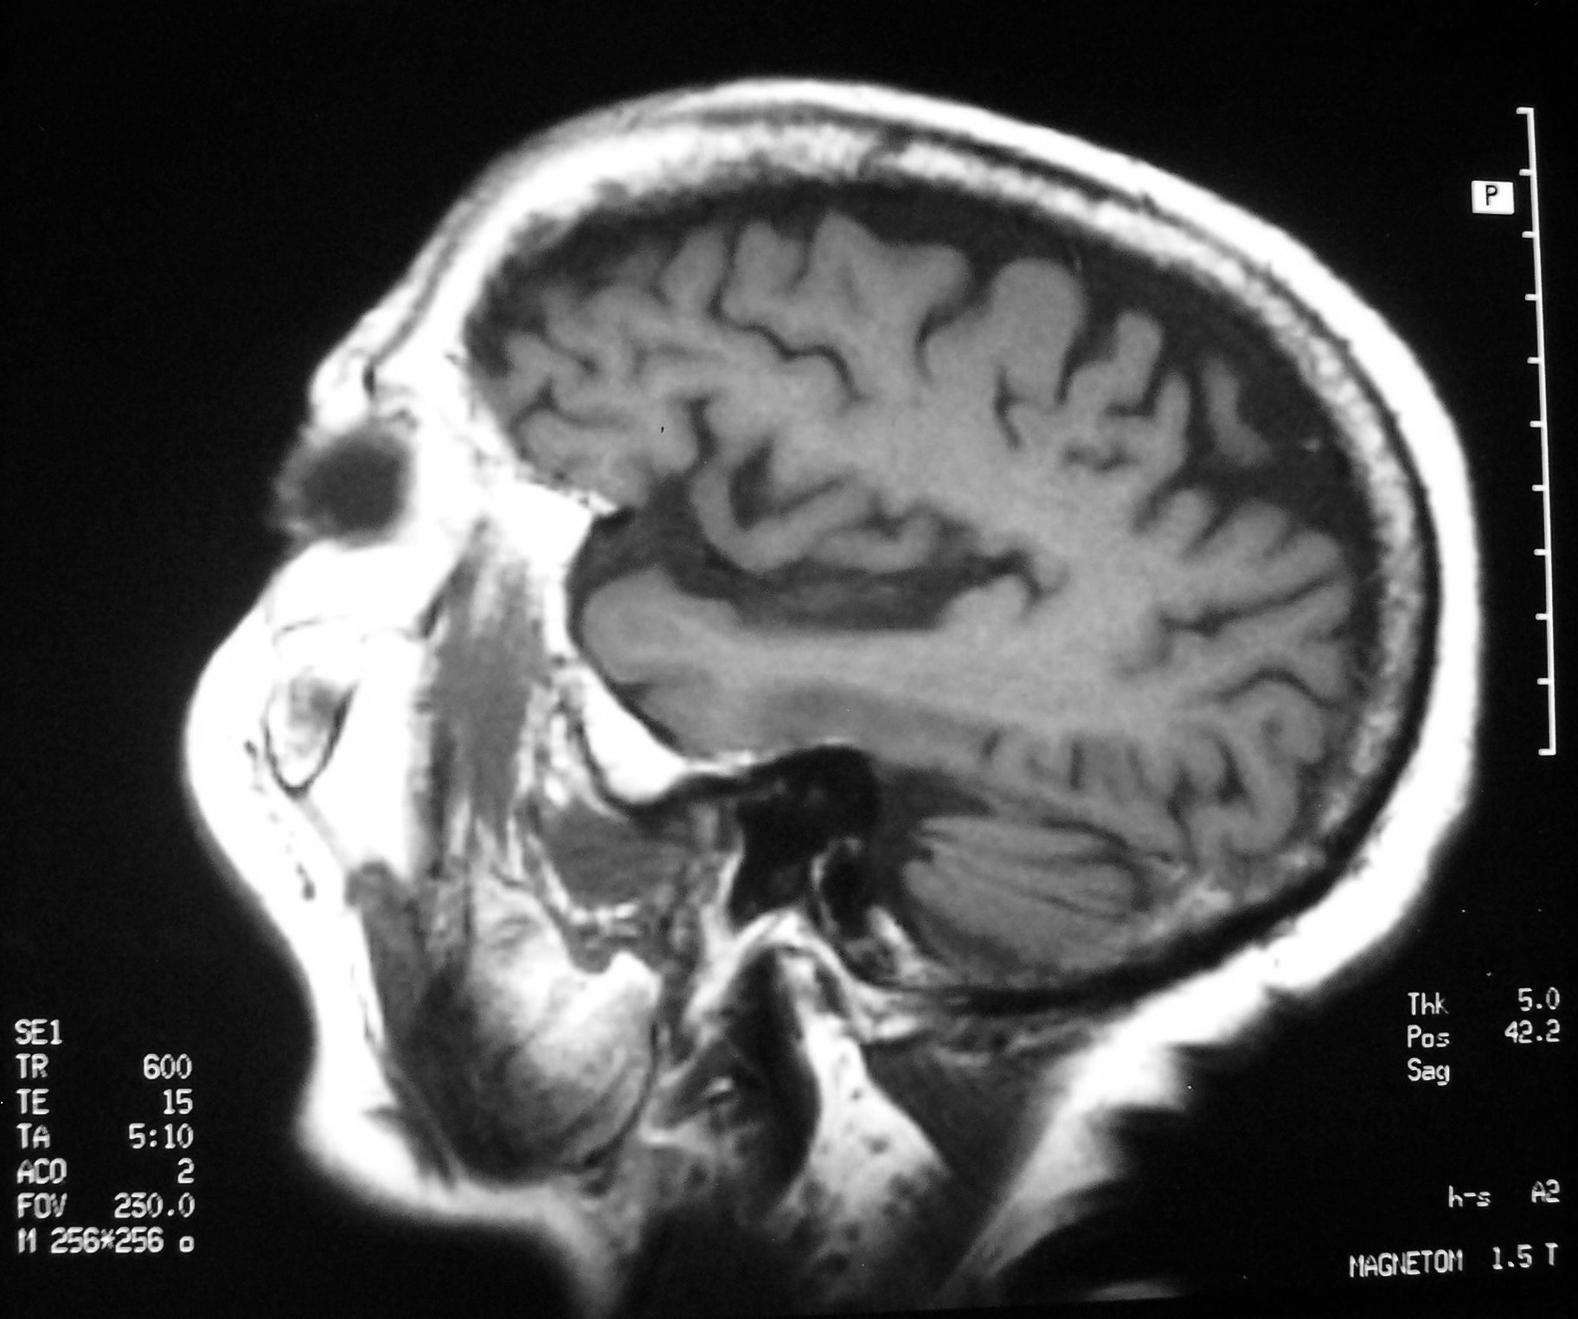
Sylvian Fissure
Temporal Lobe

Slide 54
Sectional Anatomy of the Neck
Superior to Inferior

Slide 55
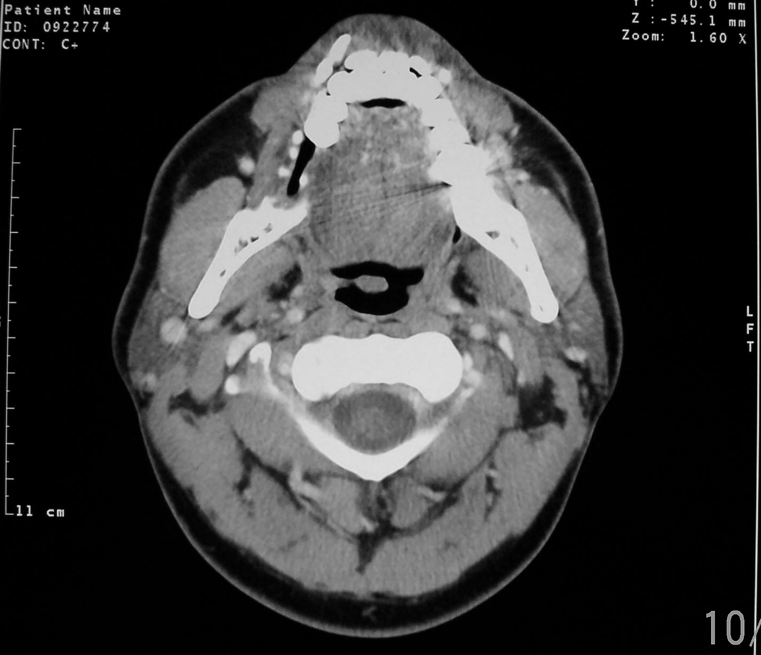
MASSETER MUSCLE
UVULA
PAROTID GLAND
TRAPEZIUS MUSCLE

Slide 56
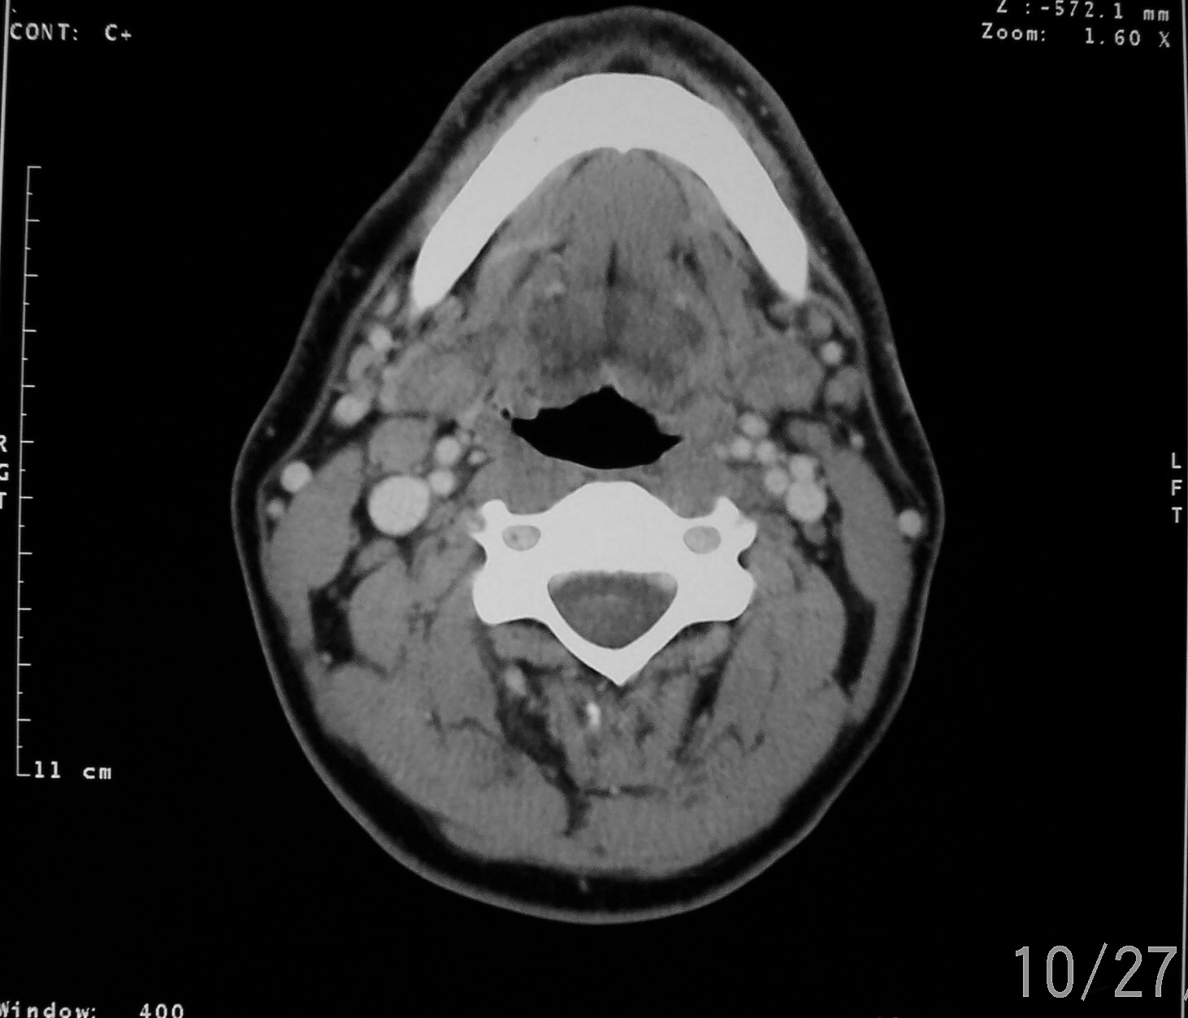
TONGUE
ECA
ICA
OROPHARYNX
IJV
SCM MUSCLE

Slide 57
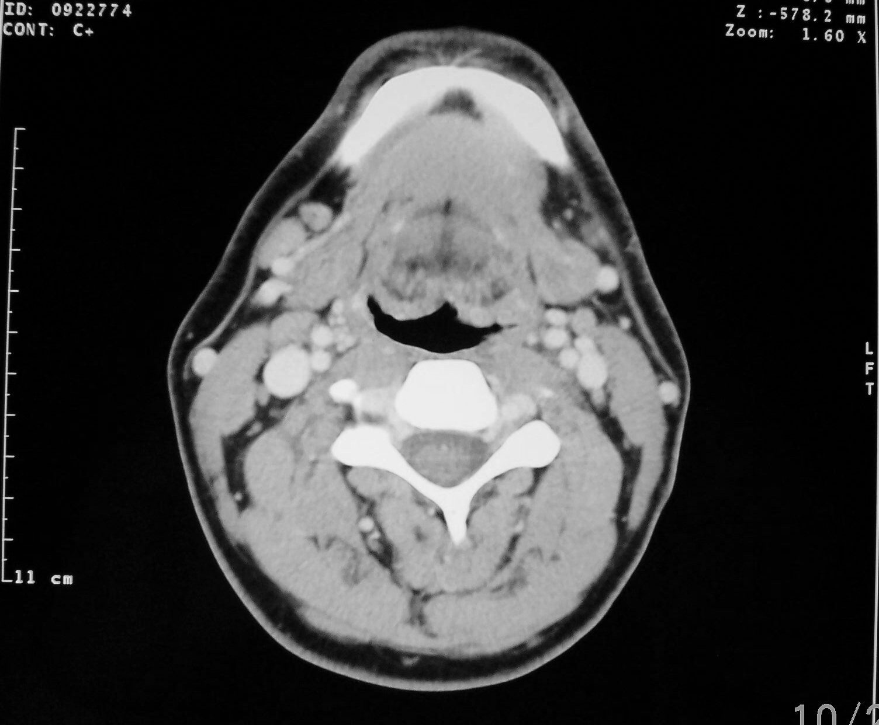
SCM MUSCLE
LAMINA
ERECTOR SPINAE MUSCLE

Slide 58
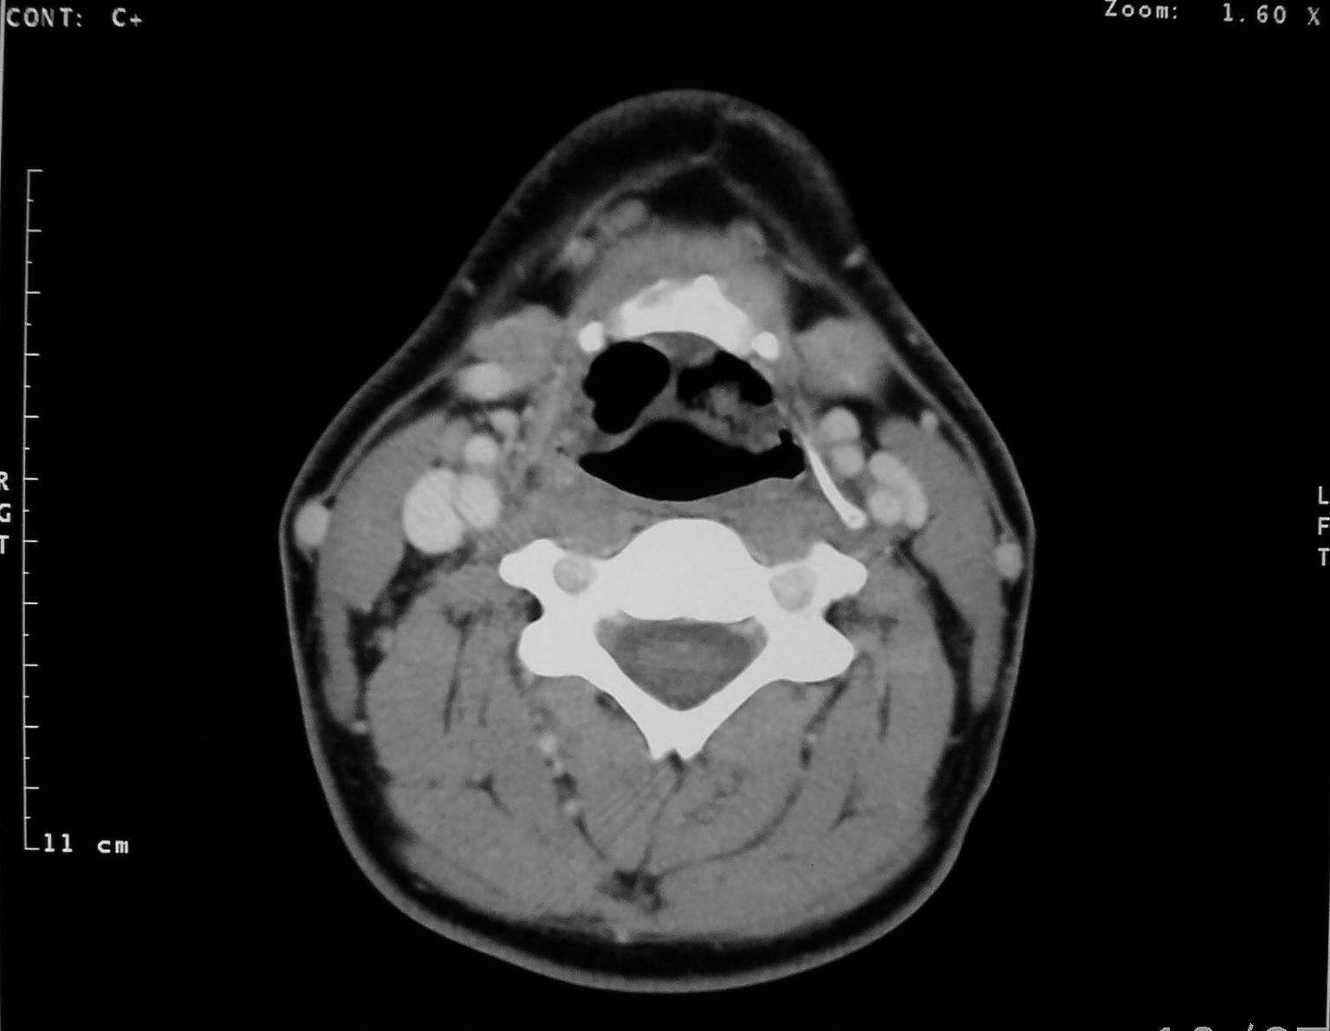
VALLECULAE
PLATYSMA MUSCLE
SUBMANDIBULAR GLAND
EPIGLOTTIS

Slide 59
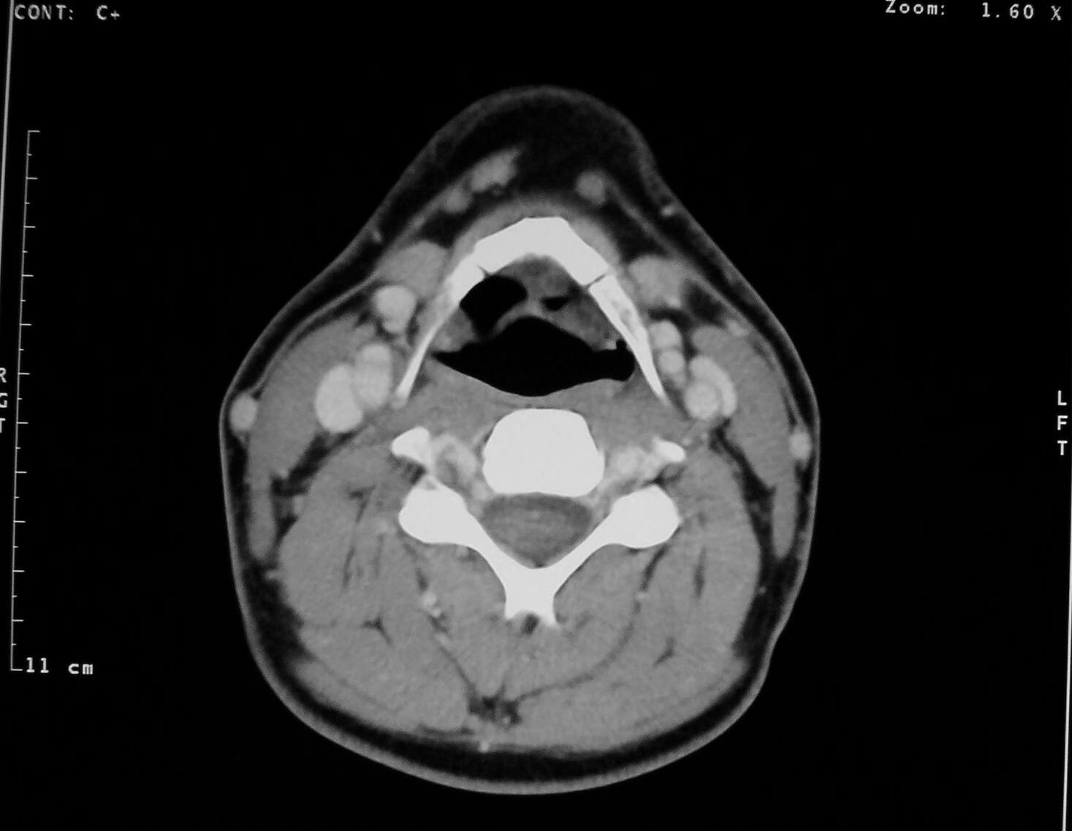
CAROTID SINUS
HYOID BONE

Slide 60
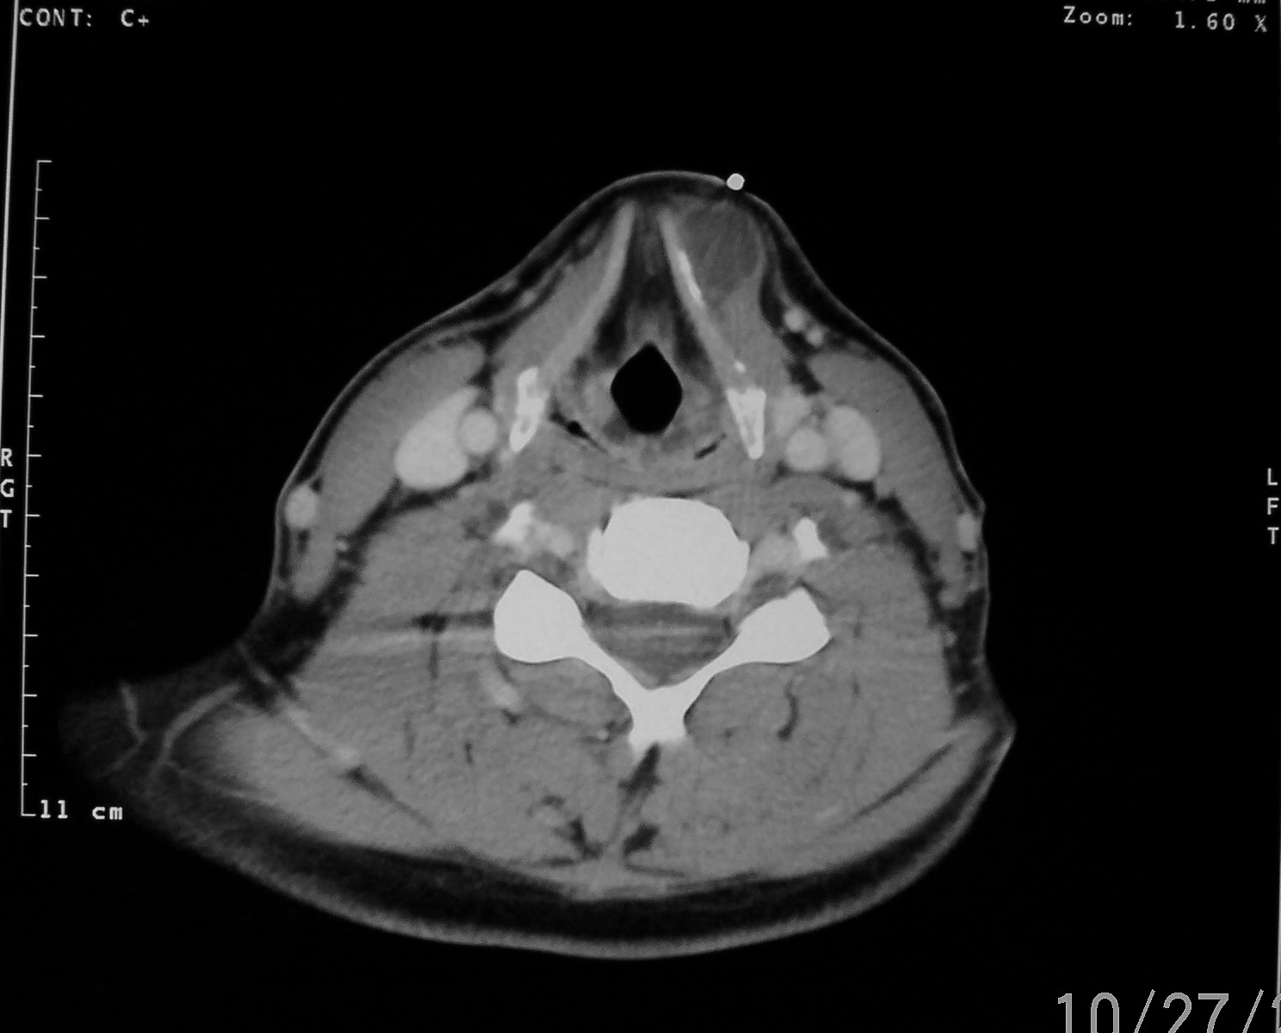
THYROID CARTILAGE
ARYEPIGLOTTIC FOLD
RT CCA
RT IJV
PYRIFORM RECESS

Slide 61
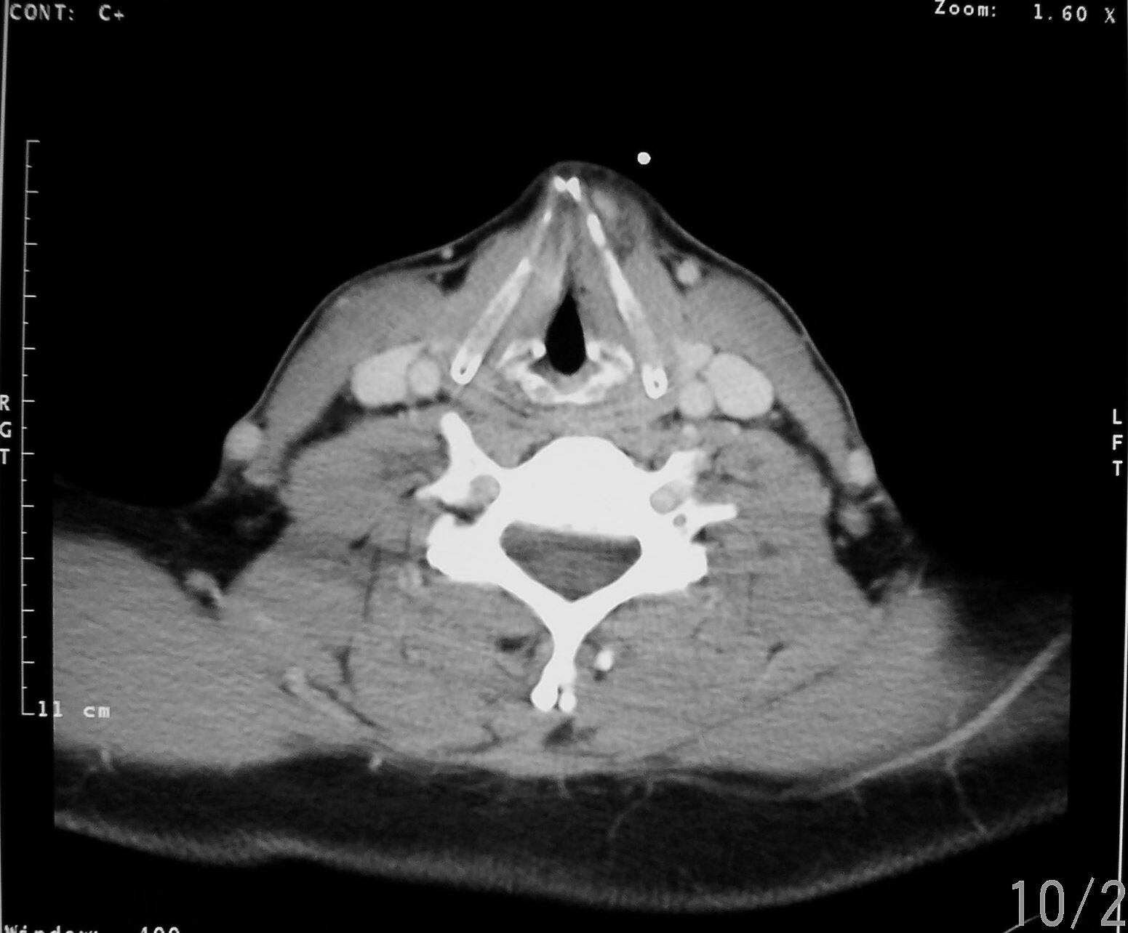
THYROID CARTILAGE
TRUE VOCAL CORD
ARYTENOID CARTILAGE
SCM MUSCLE
VERTEBRAL ART.

Slide 62
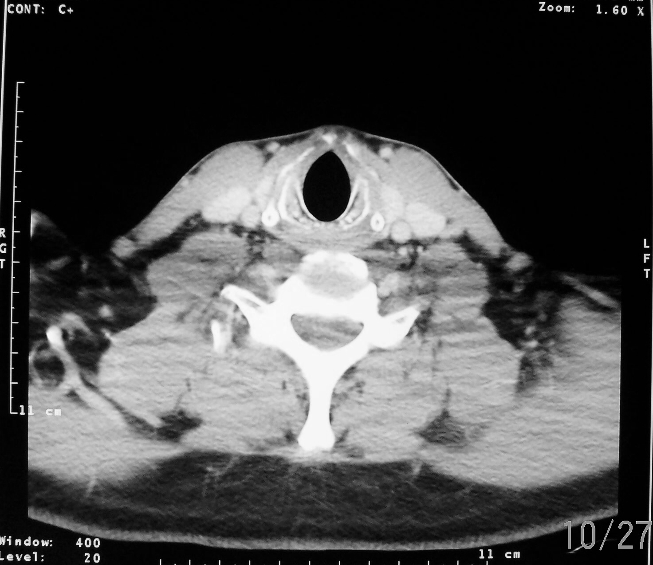
THYROID CARTILAGE
CRICOID CARTILAGE

Slide 63
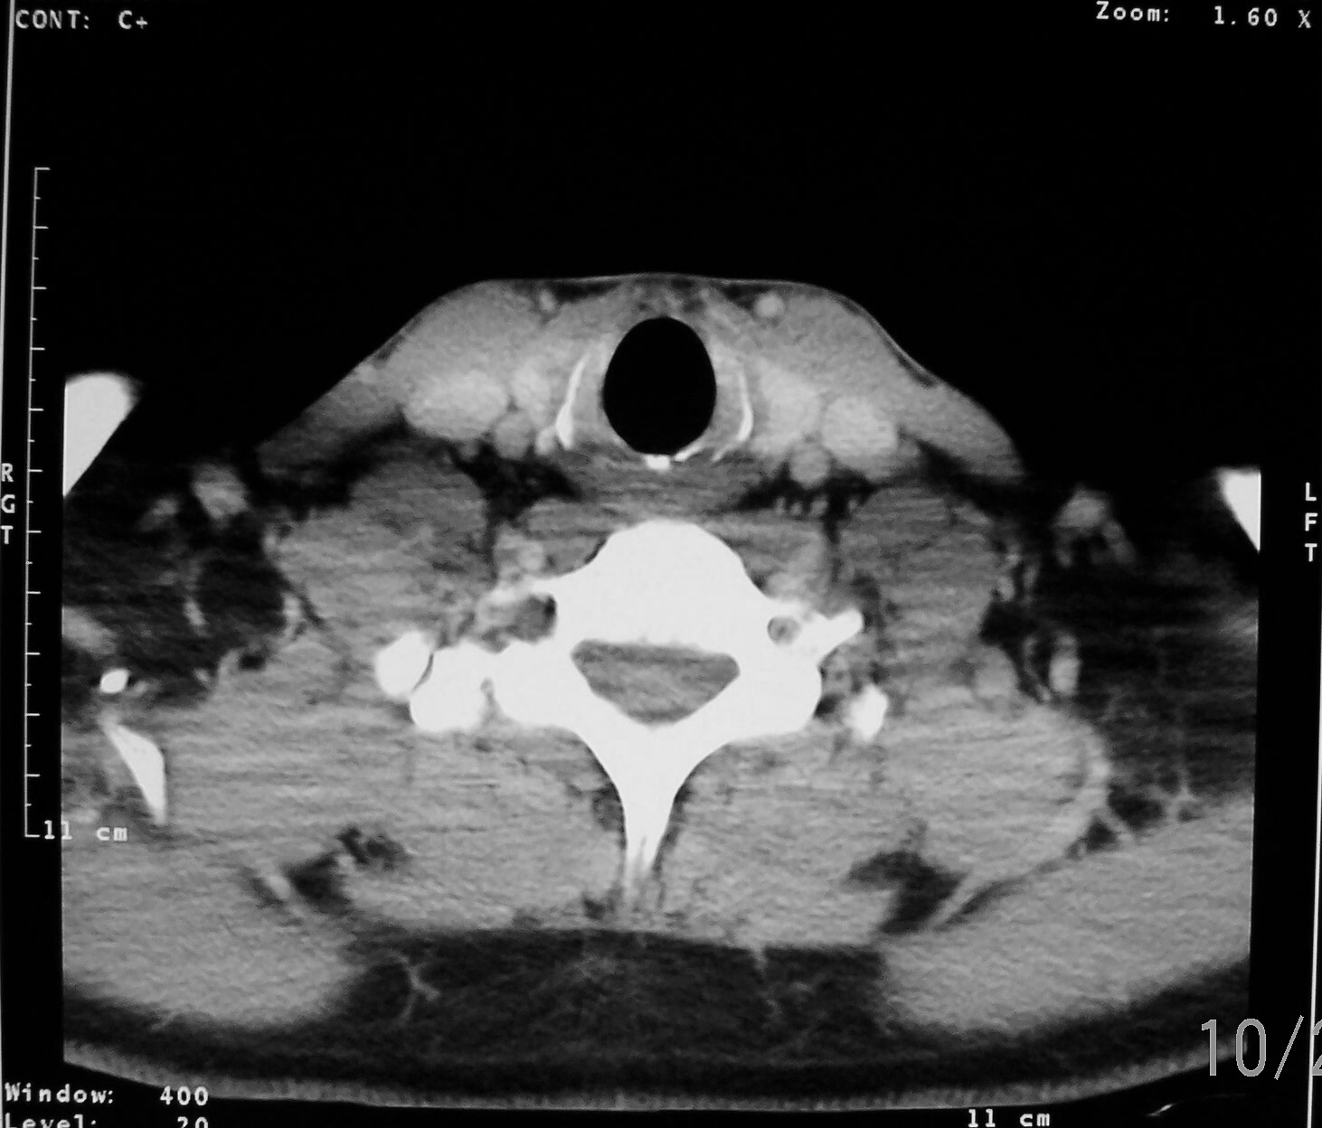
THYROID GLAND
LT CCA
LT IJV

Slide 64
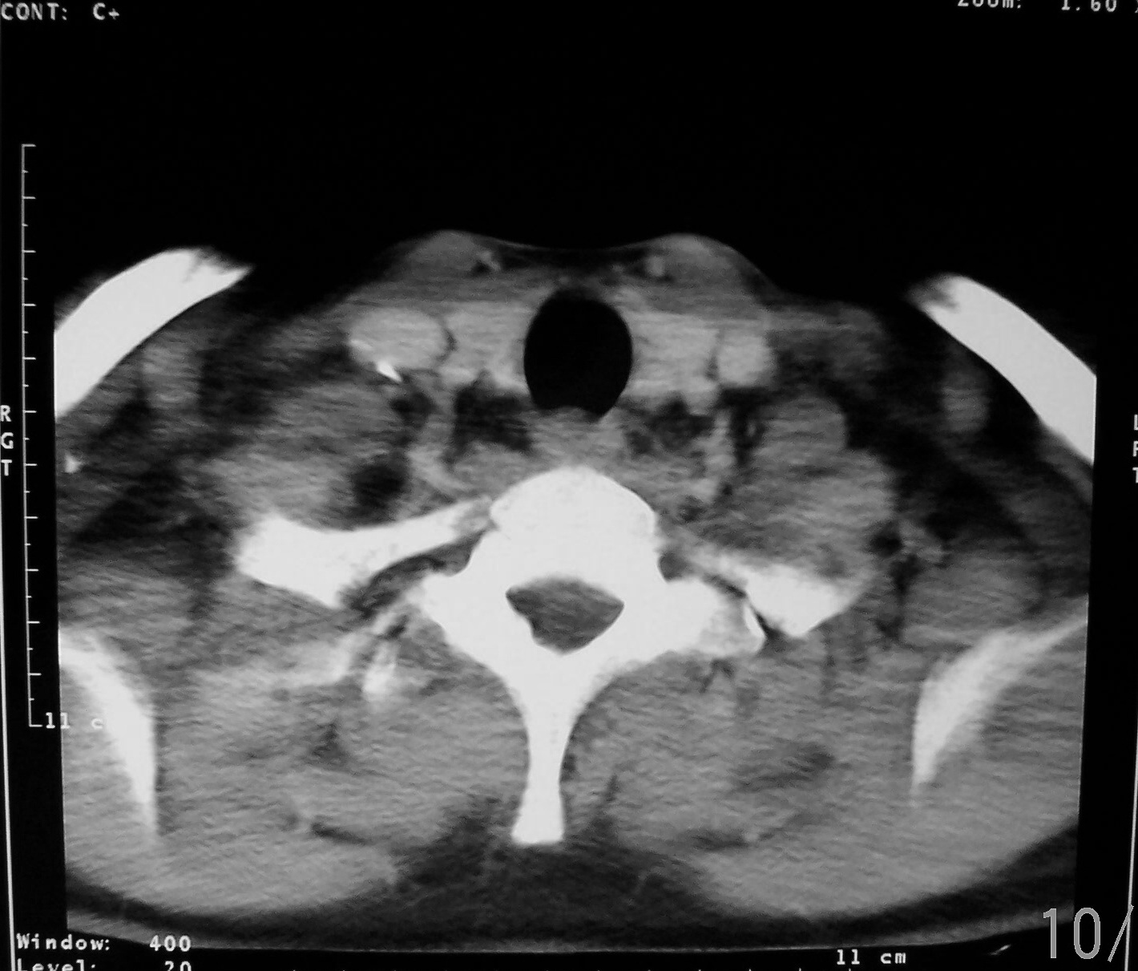
THYROID GLAND
TRACHEA
ESOPHAGUS

Slide 65
MR Anatomy of the Thorax

Slide 66
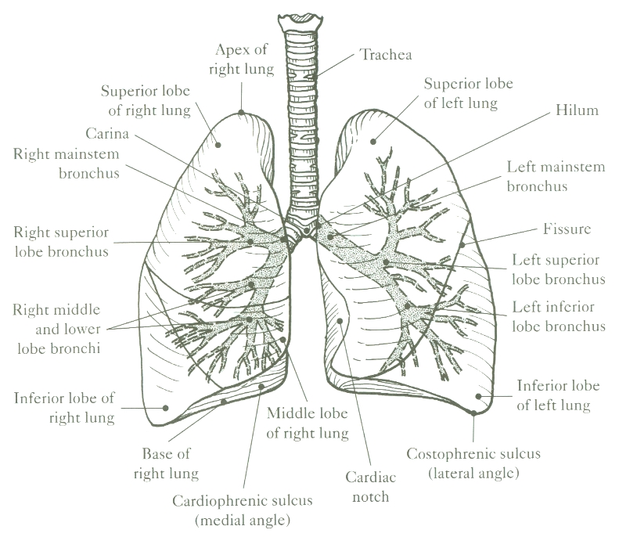

Slide 67
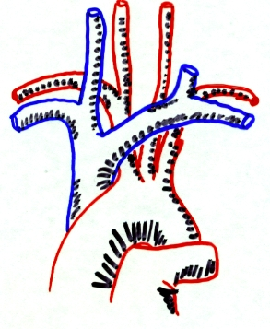

Slide 68
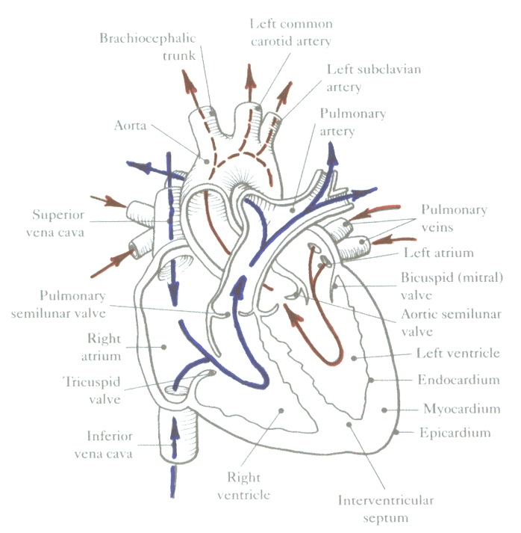

Slide 69
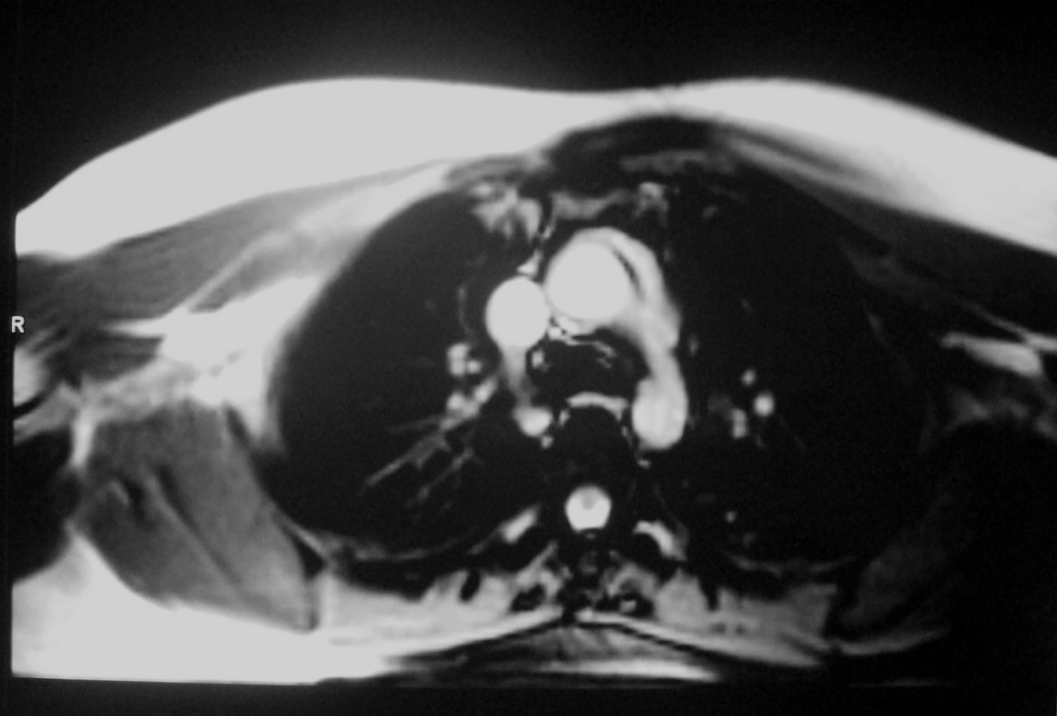
Bright Blood Technique The Axial Plane
Ascending Aorta
SVC
Descending Aorta

Slide 70
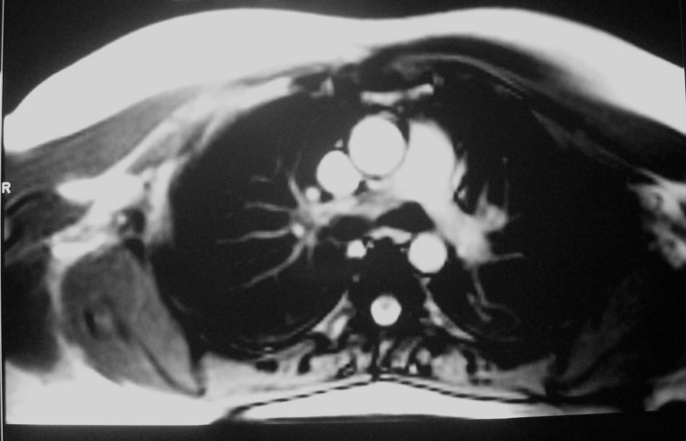
The Axial Plane cont.
Ascending Aorta
SVC
Pulmonary Trunk
Descending Aorta
Left Pulmonary Artery

Slide 71
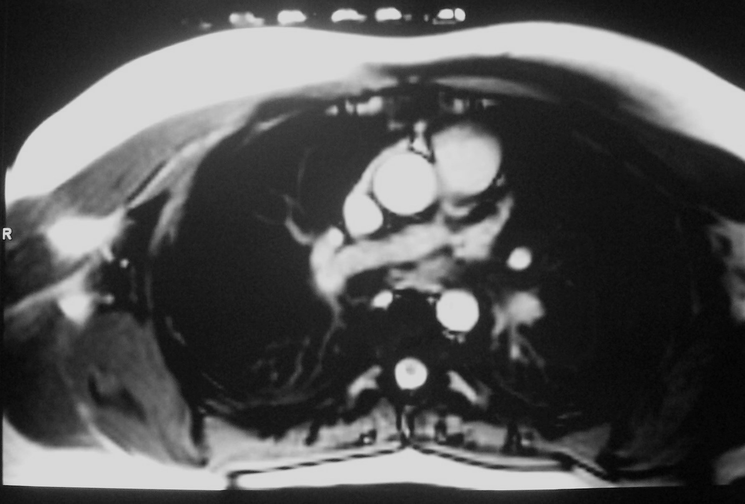
The Axial Plane cont.
Pulmonary Trunk
SVC
Ascending Aorta
Right Pulmonary Artery
Descending Aorta

Slide 72
The Axial Plane cont.
Pulmonary Trunk
Right Atrium
Ascending Aorta
Left Atrium

Slide 73
The Axial Plane cont.
Pulmonary Trunk
Right Atrium
Aortic Root
Left Atrium

Slide 74
The Axial Plane cont.
RVOT
Right Atrium
LVOT
Left Atrium

Slide 75
The Axial Plane cont.
Right Ventricle
Left Ventricle
Left Atrium
Right Atrium

Slide 76
The Axial Plane cont.
Interventricular Septum
Right Ventricle
Left Ventricle
Right Atrium

Slide 77
The Axial Plane cont.
Right Ventricle
Left Ventricle
IVC

Slide 78
Coronal Images of the Chest
Posterior to Anterior

Slide 79
Apices
Descending Aorta
Diaphragm

Slide 80
Scalene Muscles
Trapezius Muscle
Coracoid Process

Slide 81
Aortic Arch
Primary Bronchi

Slide 82
Aortic Arch
Carina
Pulmonary Trunk
LT Pulmonary Artery

Slide 83
Trachea
Aortic Arch
LT Atrium
RT Pulmonary Artery

Slide 84
Aortic Arch
Pulmonary Trunk
SVC
LT Atrium
LT Ventricle

Slide 85
Ascending Aorta
Pulmonary Trunk
SVC
Aortic Root
LVOT
RT Atrium
LT Ventricle

Slide 86
Ascending Aorta
Pulmonary Trunk
RT Atrium
LT Ventricle

Slide 87
Ascending Aorta
Pulmonary Trunk
LT Ventricle
RT Atrium
RT Ventricle

Slide 88
RVOT
RT Atrium
RT Ventricle

Slide 89
Breast Glandular Tissue
RT Ventricle

Slide 90
MRI Heart Images

Slide 91
Interventricular septum
Lt. ventricle
Rt. ventricle
Rt. atrium
Lt. atrium
4 Chamber view
(HLA)

Slide 92
Lt. ventricle
Mitral valve
Lt. atrium
2 chamber view (VLA)

Slide 93
RVOT
Myocardium
Tricuspid valve
Mitral valve
Short axis view

Slide 94
Ascending aorta
Myocardium
Lt. ventricle
LVOT
Mitral valve
Lt. atrium
3 chamber view

Slide 95
Lt. coronary artery
Ascending aorta
Papillary muscle
Aortic semilunar valve
Lt. ventricle
Aortic outflow view

