Slide 1
Strategic Planning

Slide 2
What is Strategic Planning?
“Strategic planning is an organizational management activity that is used to set priorities, focus energy and resources, strengthen operations, ensure that employees and other stakeholders are working toward common goals, establish agreement around intended outcomes/results, and assess and adjust the organization's direction in response to a changing environment.”
http://www.balancedscorecard.org/BSC-Basics/Strategic-Planning-Basics

Slide 3
So What Does That Mean?
Disciplined effort that produces fundamental decisions and actions that shape and guide what an organization is, who it serves, what it does, and why it does it
focus on the future
An effective plan articulates
where an organization is going
the actions needed to make progress, and
how it will know if it is successful
http://www.balancedscorecard.org/BSC-Basics/Strategic-Planning-Basics

Slide 4
Why Do We Need a Strategic Plan?
Critical component of good management and governance
Helps assure that the organization remains relevant and responsive to member needs
Provides a basis for monitoring progress, and for assessing results and impact
Enables the Board to set policies and goals to guide and focus the organization
Requires an organized, serious effort that takes time and energy

Slide 5
The Board of Directors will ultimately approve the plan and use it as a guide to direct decisions and actions.

Slide 6
Because the Board will use the Strategic Plan as a guiding document, they should be actively involved in creating it!

Slide 7
Board of Directors as Strategic Thinkers…
“Where should we be going?”
“What’s the plan to get us where we need to be?”
“How should we measure success?”

Slide 8
How to Get Started
Each Strategic Plan is time-sensitive
Written with a certain timeframe in mind
usually 5 years
About 2 years before the end of the Strategic Plan, the organization should begin creating the new Plan

Slide 9
Set a timetable working backwards
Implementation: May 2024
Approval by Board: January 2024
New Plan Created: February – December 2023
SWOT Analysis: February 2023
SWOT Survey: November 2022
Review of Current Plan: May 2022

Slide 10
First Things First
Review the current plan:
Vision
Mission
Core Values
Strategic Initiatives

Slide 11
Vision
Articulates what the organization wants to become
Aspirational!

Slide 12
Examples of Vision Statements
Alzheimer’s Association: A world without Alzheimer’s
Make-A-Wish: That people everywhere will share the power of a wish
The Nature Conservancy: To leave a sustainable world for future generations

Slide 13
OSRT Vision Statement
“The OSRT will be the voice of Ohio medical imaging and radiologic science professionals.”
What do you like about it?
What would you change about it?

Slide 14
Mission Statement
A written declaration of an organization’s core purpose and focus
Serves as a filter to separate what is important from what is not
Clearly states who will be served and how
Communicates an intended direction to the entire organization
Who are we?
What is the organization and what does it do?
What are the issues that the organization exists to meet?
What makes the organization unique or distinctive?

Slide 15
OSRT Mission Statement
“The OSRT will advocate for medical imaging and radiologic science professionals by advancing professional practice to enhance the quality of patient care.”
What do you like about it?
What would you change about it?

Slide 16
Core Values
Enduring, passionate, core beliefs
Core values meld together to form the organization’s culture
The heart of what the organization values
What is important to the organization?

Slide 19
Strategic Initiatives
Written as blanket goals statements for the organization
Increase Membership
Increase active members
Maintain active members
Increase student membership
Matriculate student members to active members
Promote Advocacy Efforts
Serve as a professional resource to preserve and protect licensure/rules
Publicize advocacy efforts

Slide 20
Strategic Planning Process
In the planning process, we’ve reviewed the current vision and mission statements, the core values, and the strategic goals…

Slide 21
Strategic Planning

Slide 22
Strategic Planning
Opportunities – What external factors are helpful to our goals? These should be prioritized and maximized.
Threats – What external factors can damage our performance or be harmful to our goals? These should be countered and minimized.

Slide 23
Internal Environment
Strengths – What do we do well now that are helpful to achieving our goals? Things that are good now – should be refined and used as positive leverage
Weaknesses – What do we not do well or what are we doing that may be harmful to our goals? Things that are bad now – remedy, change, or stop doing them

Slide 24
External Environment
Opportunities – What external factors are helpful to our goals? These should be prioritized and maximized.
Threats – What external factors can damage our performance or be harmful to our goals? These should be countered and minimized.

Slide 25
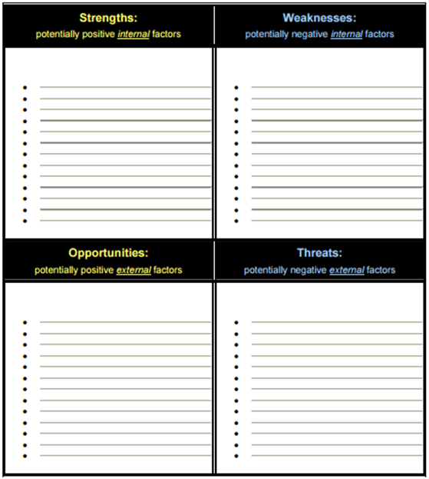
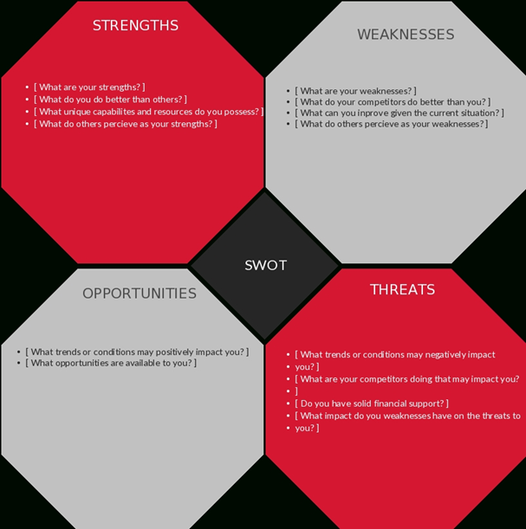
SWOT Analysis Templates

Slide 26
After the SWOT
Identify key issues, questions, and choices to be addressed as part of the process.
Prioritize strategic issues that emerged from the SWOT and then prioritize them in terms of importance, timing, and feasibility.
Use items from the SWOT to create specific strategic initiatives/goals

Slide 27
Questions to Consider When Developing Goals
Is the goal consistent with the organization’s mission, values, and operating principles?
Is the goal practical, given personnel and financial resources?
Is the goal likely to lead to substantial benefits that justify the costs in time and other resources?
Is the goal appropriate at this given time?

Slide 28
Development of an Action Plan
What steps, processes, actions are needed to accomplish each goal? No more than 3-5 per goal.
What metric is used to measure success or failure
Who is responsible for meeting and reporting on each action step? This person or committee is accountable!
What is the timeline for completion of each action step?
What is the budget associated with each action step?
Procedures should be built in for modification – the action steps should be fluid, changing as the environment or organization changes, but the strategic goals should remain

Slide 29
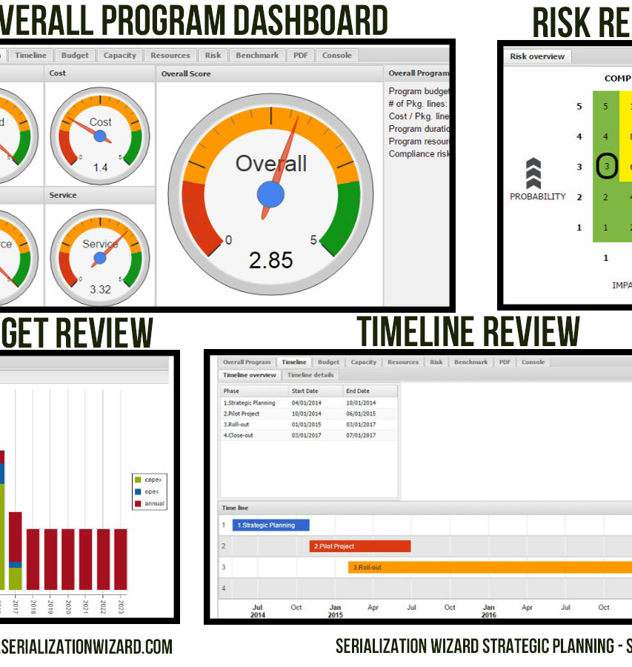
Final Product
Finalize the written Strategic Plan
Create a dashboard as a visual for your progress

Slide 30
Now Let’s Review the OSRT Strategic Plan
Notes:
Make sure to include copy after this ppt in binders

Slide 31
Approval of Strategic Plan
The Board of Directors must approve the plan via a formal vote
Final Step – Share the plan with the membership
Begin the Action Steps and collect data
Record progress on the Dashboard
Discuss at every Board of Directors’ meeting
Notes:
Make sure to include copy after this ppt in binders

Slide 32
Notes:
The strategic plan is a living document. What does that mean?
It means that the document is not final and can (and should be) revised based on organization needs and capabilities.

Slide 33
Notes:
Make sure to include copy of current strategic plan dashboard after this ppt in binders

